Slide 1
Unit 1
Present Simple
Verb Conjugation

Slide 2
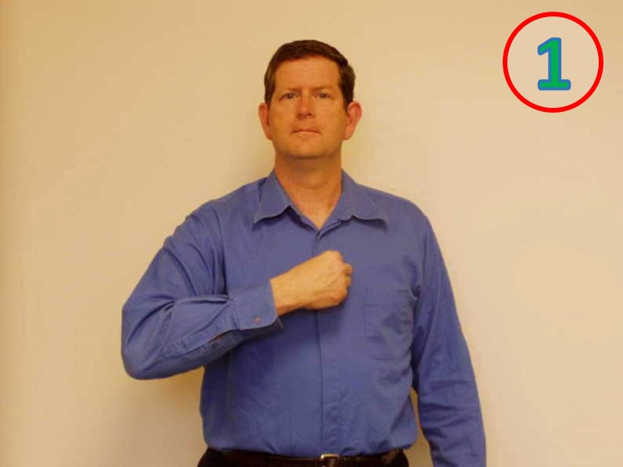
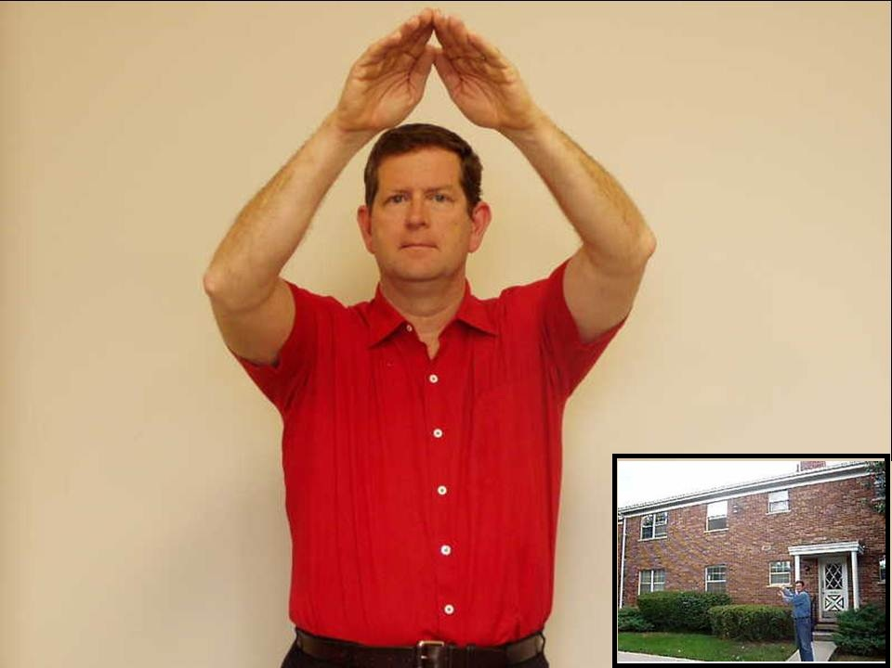

Slide 3
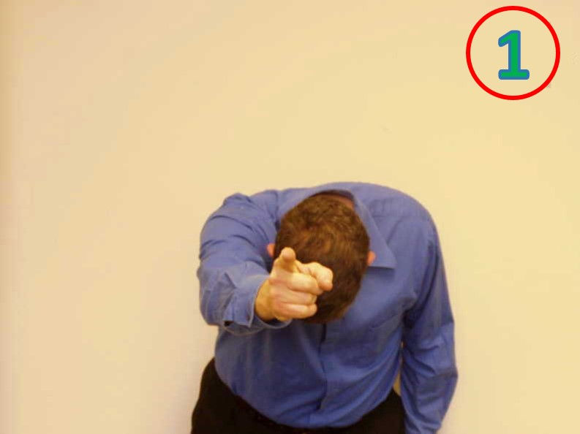
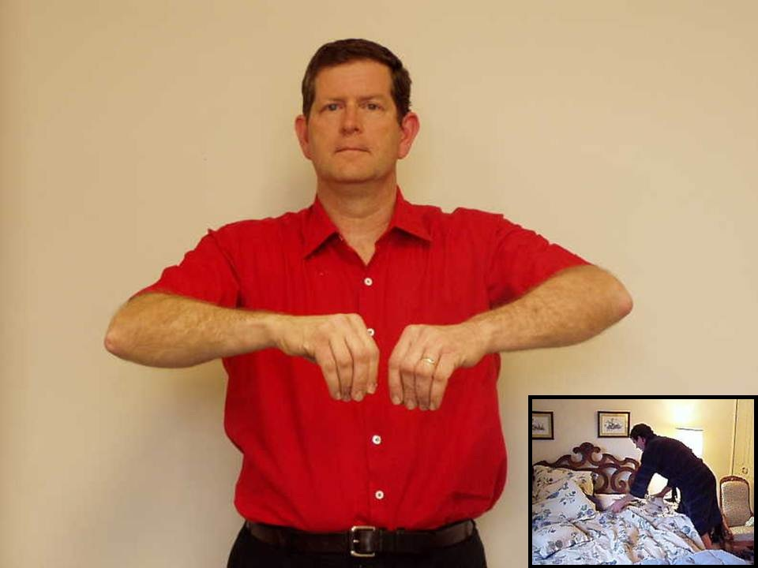

Slide 4
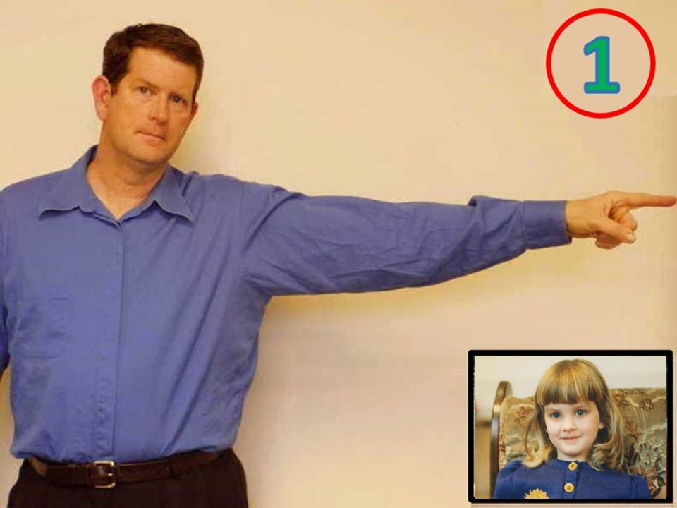

Slide 5
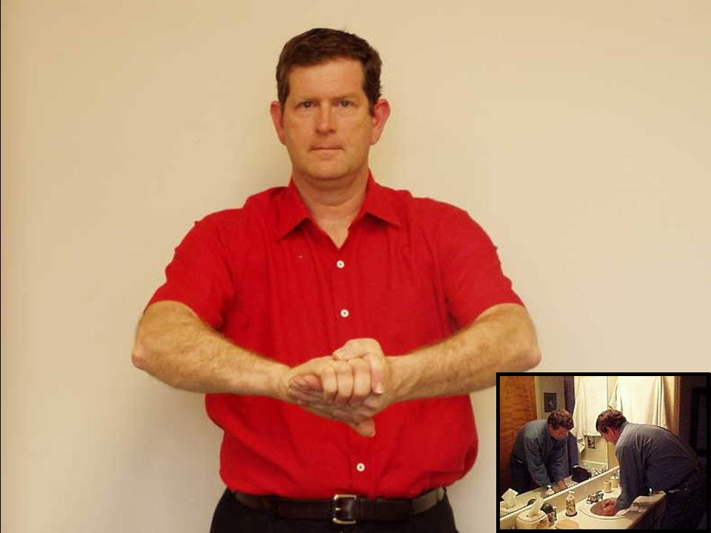

Slide 6
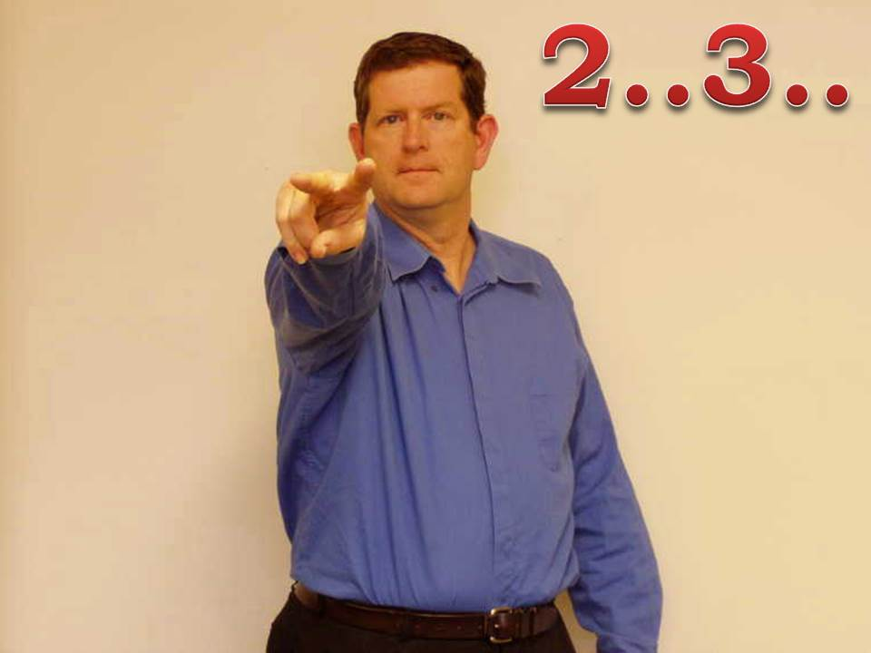
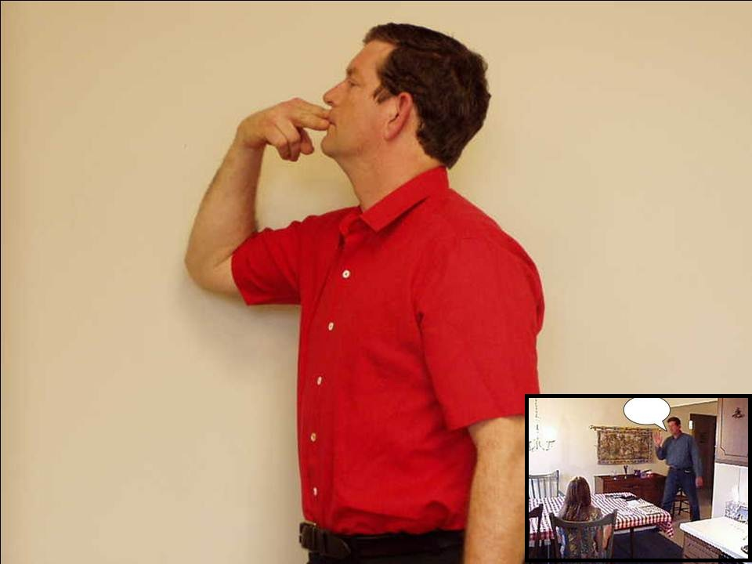

Slide 7
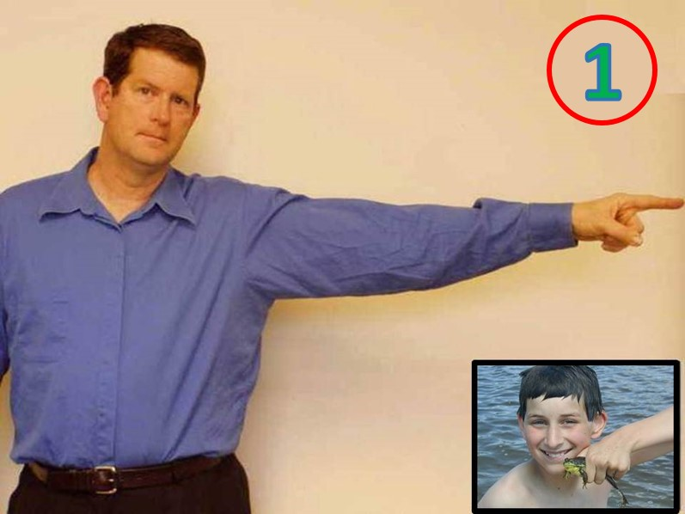

Slide 8
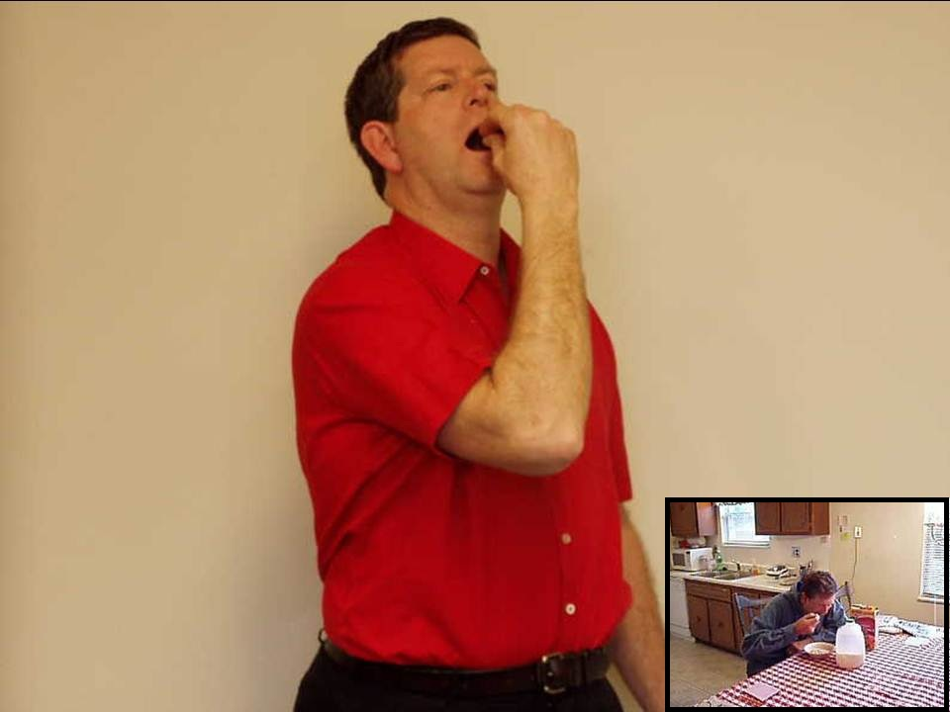

Slide 9
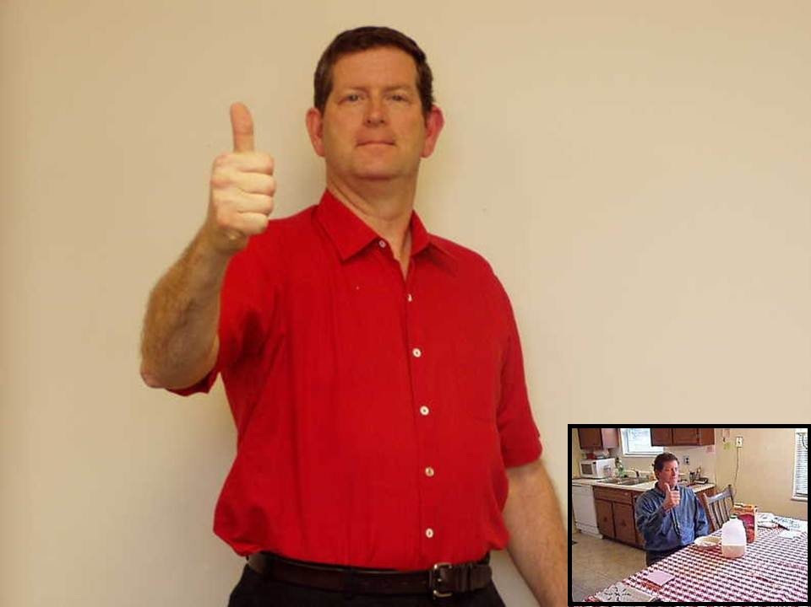

Slide 10
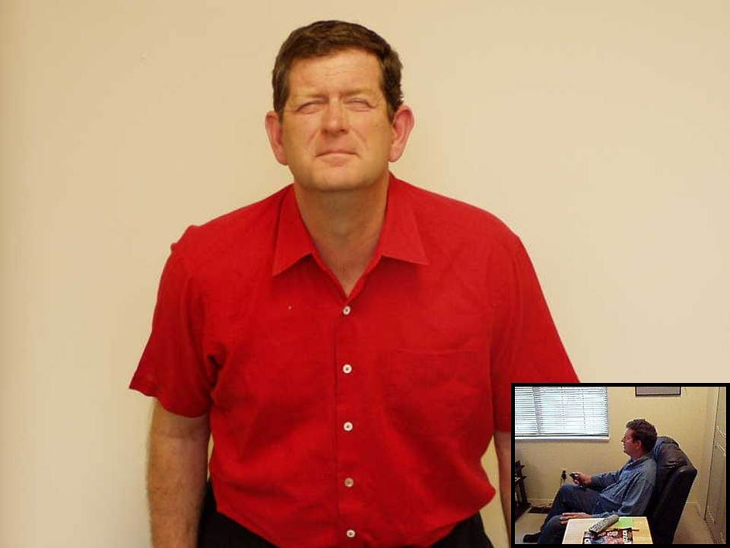

Slide 11
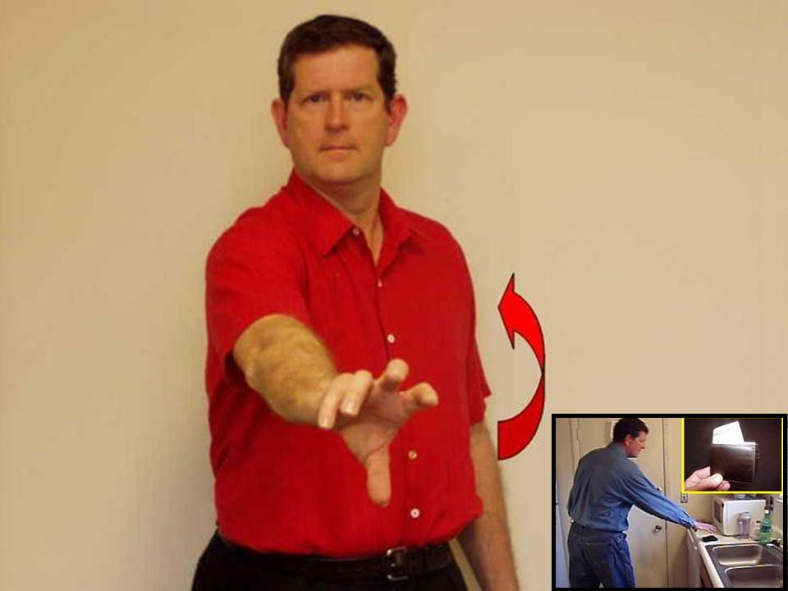

Slide 12
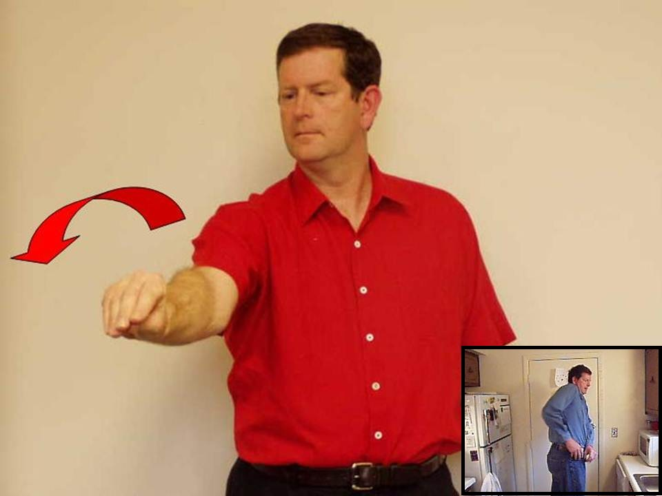

Slide 13
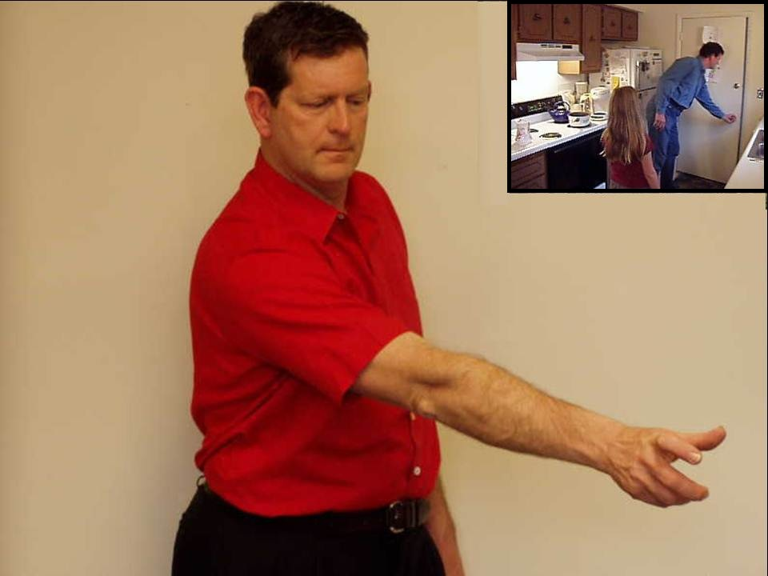

Slide 14
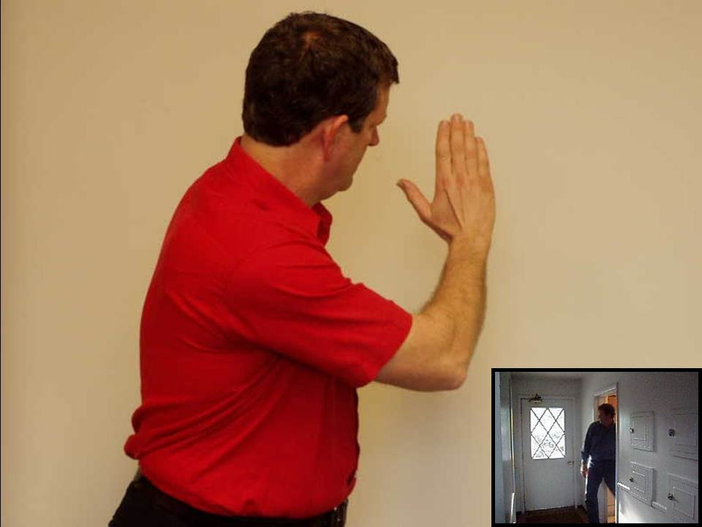

Slide 15
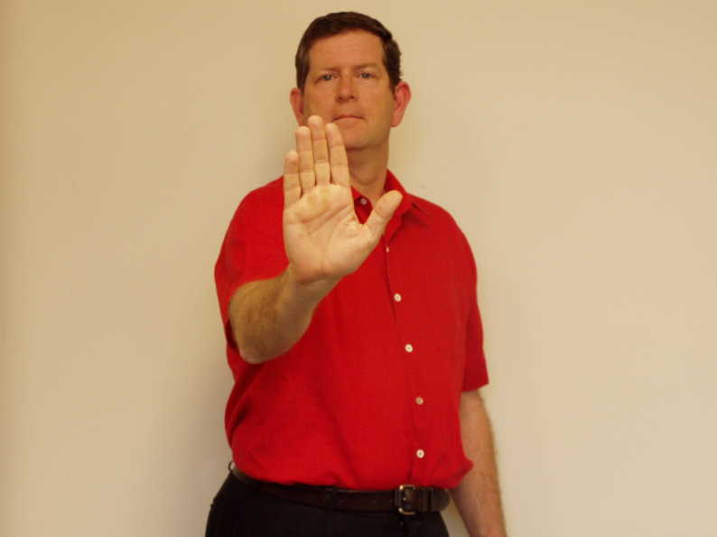

Slide 16
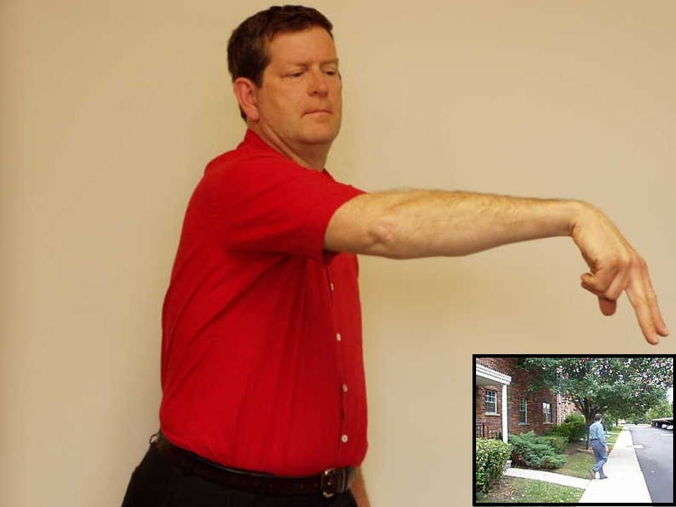

Slide 17
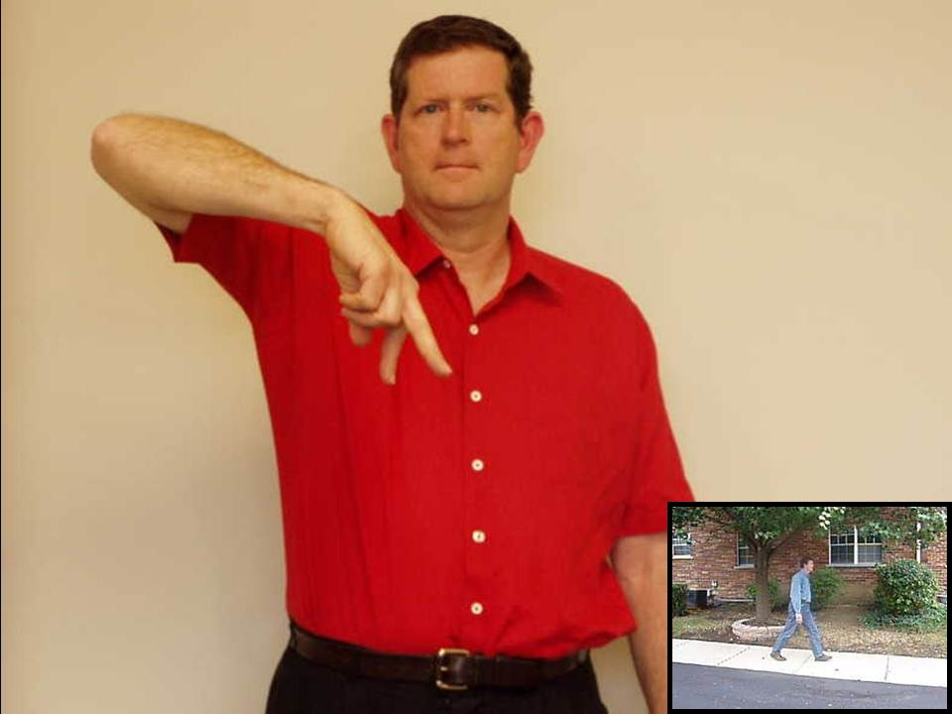

Slide 22
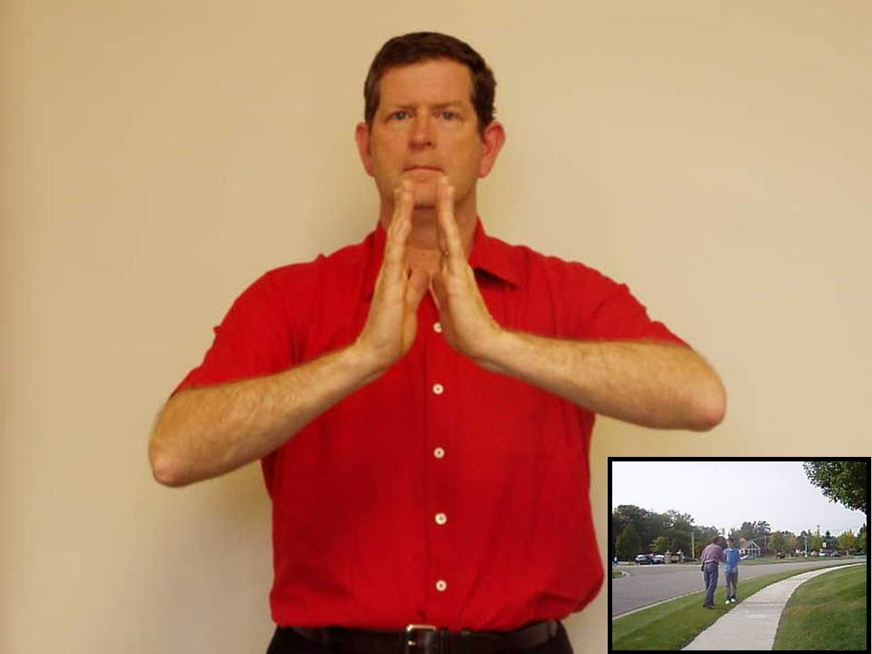

Slide 24
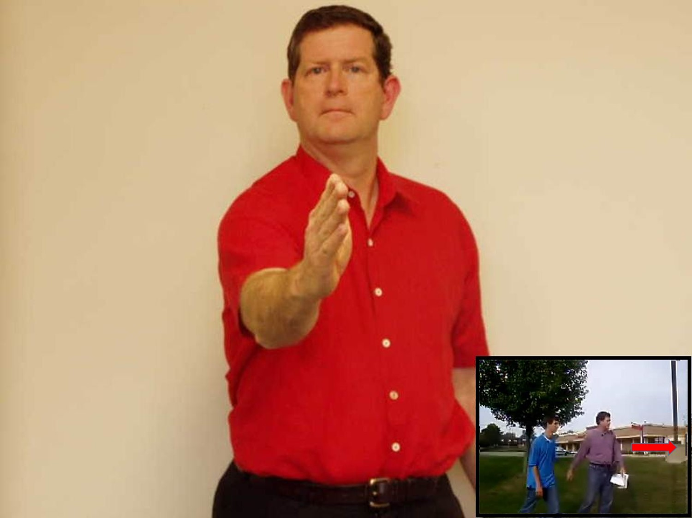

Slide 25
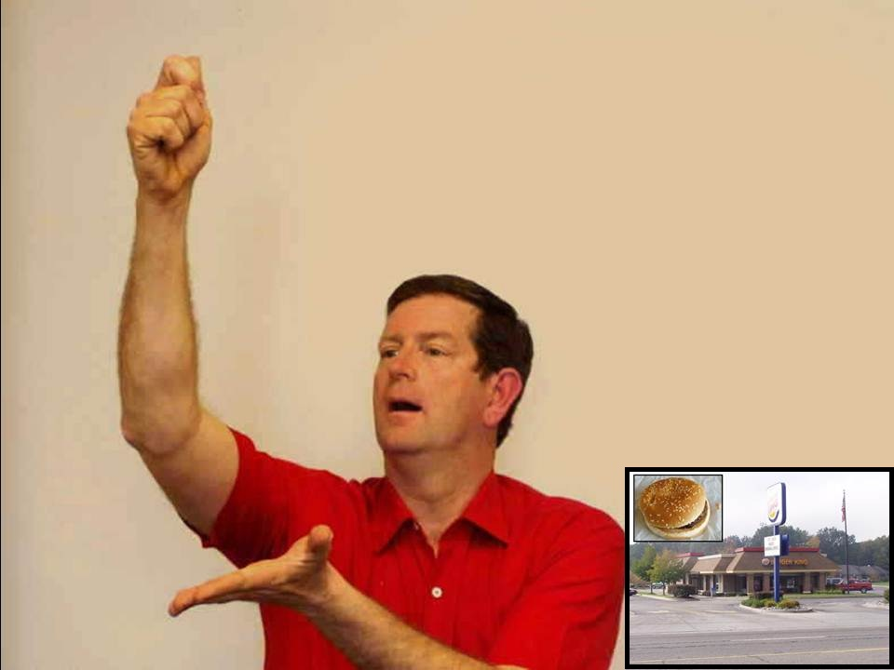

Slide 27
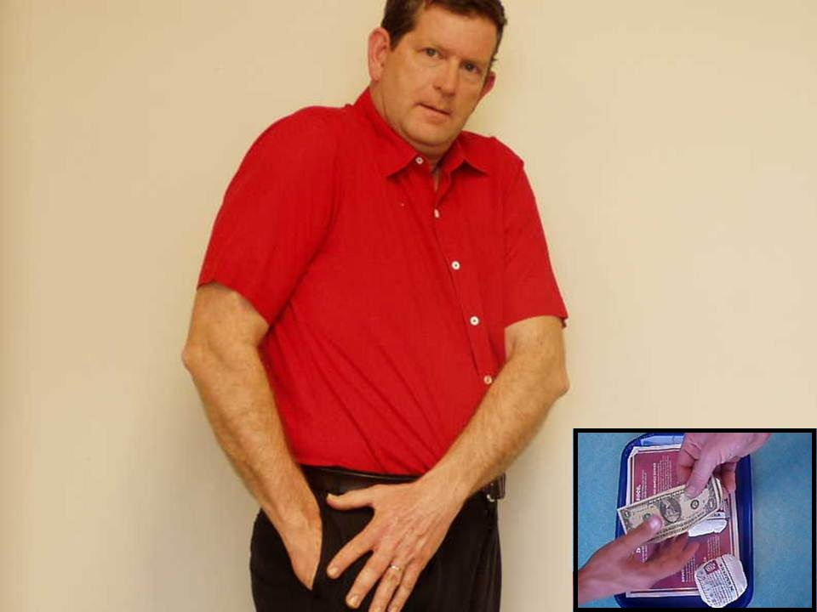

Slide 28
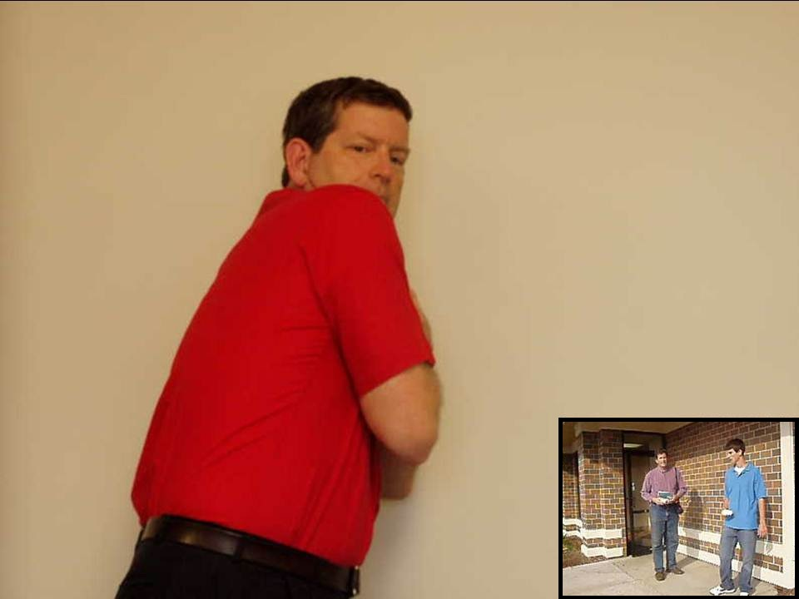

Slide 29
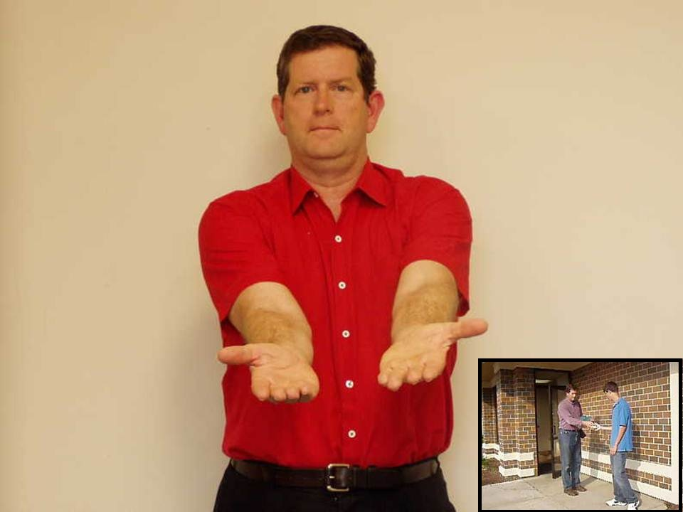

Slide 30
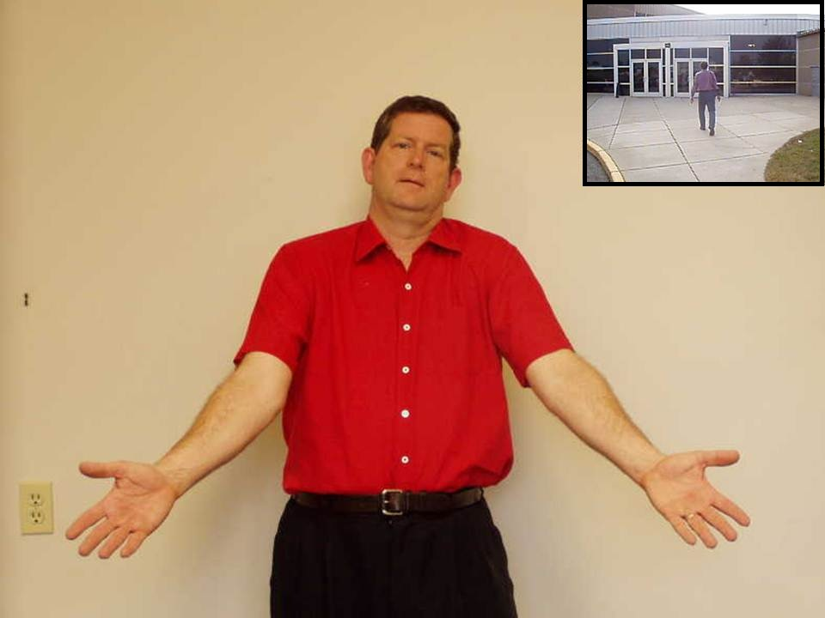

Slide 31
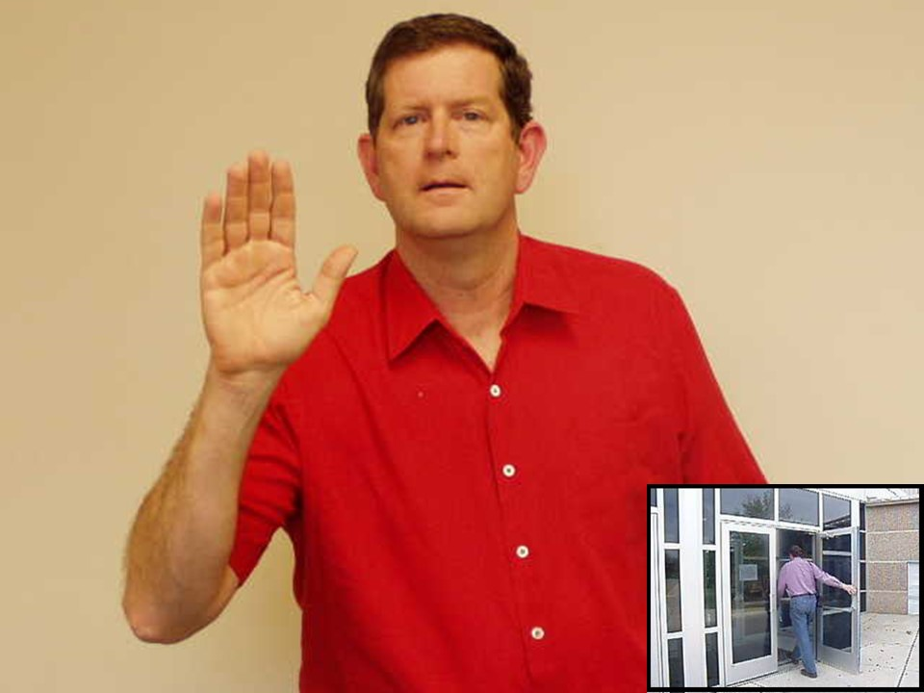

Slide 32
Unit 1
Negation and
Question Formation

Slide 33
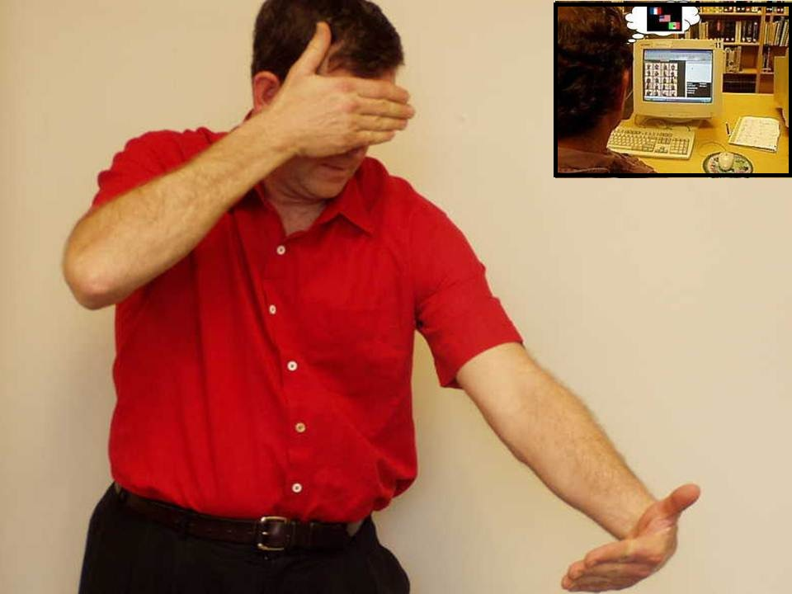

Slide 34
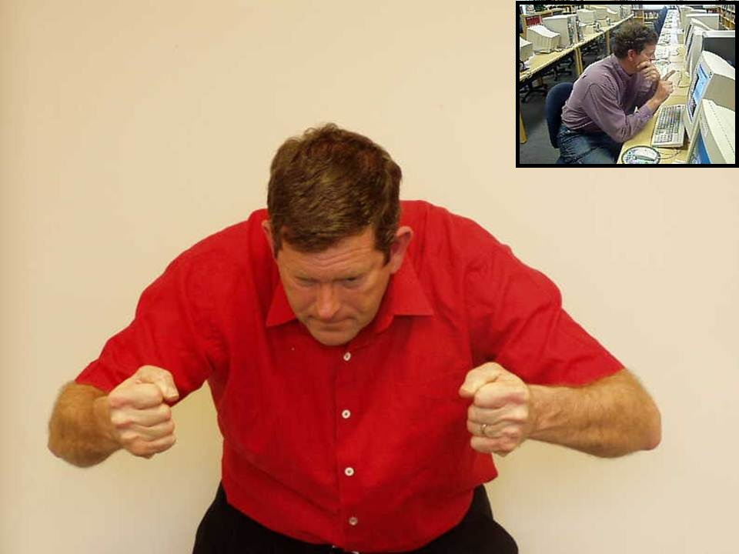

Slide 35
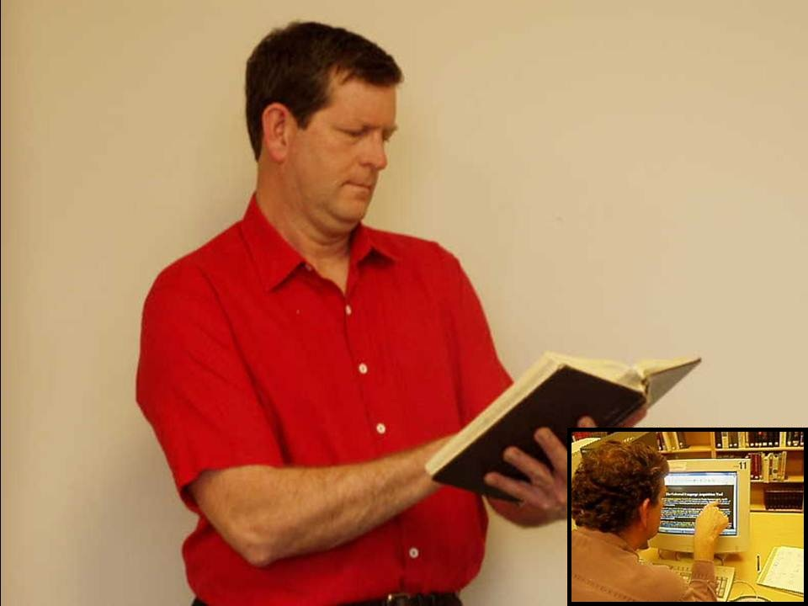

Slide 37
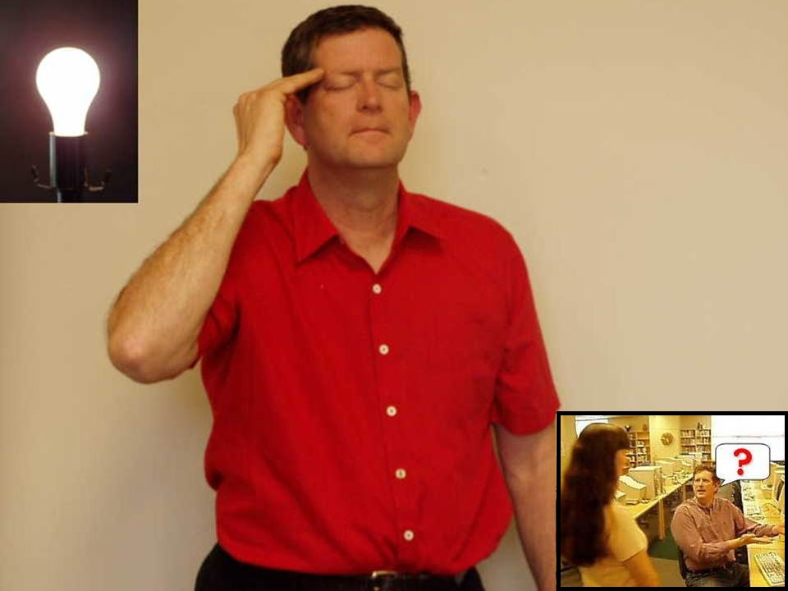

Slide 38
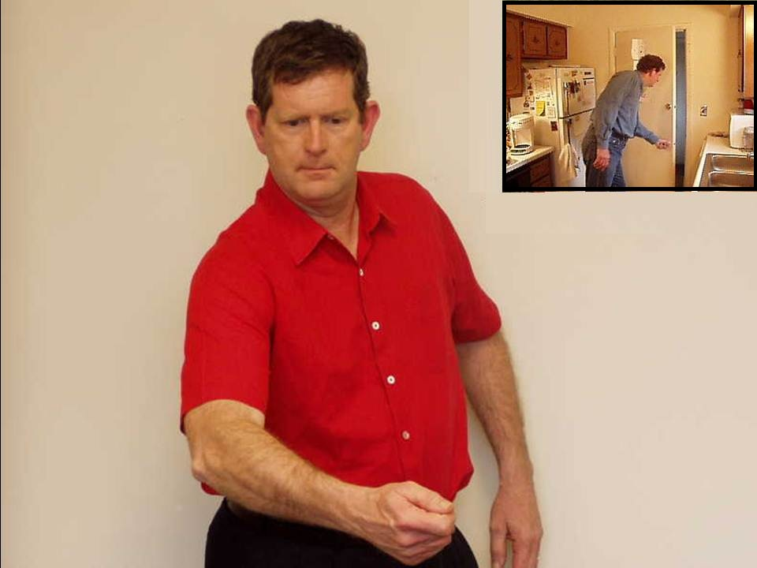

Slide 39
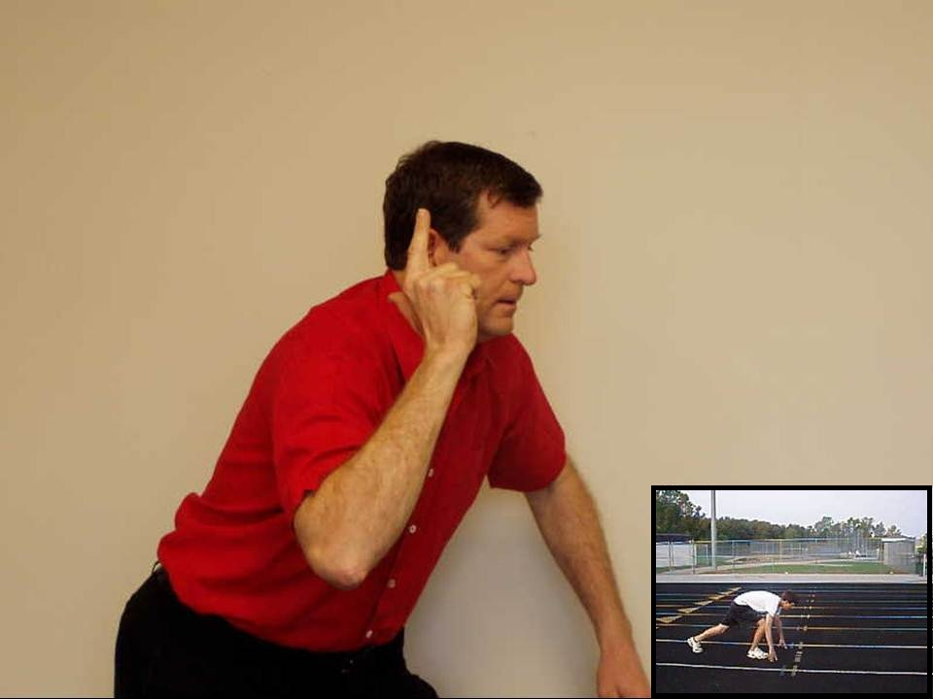

Slide 40
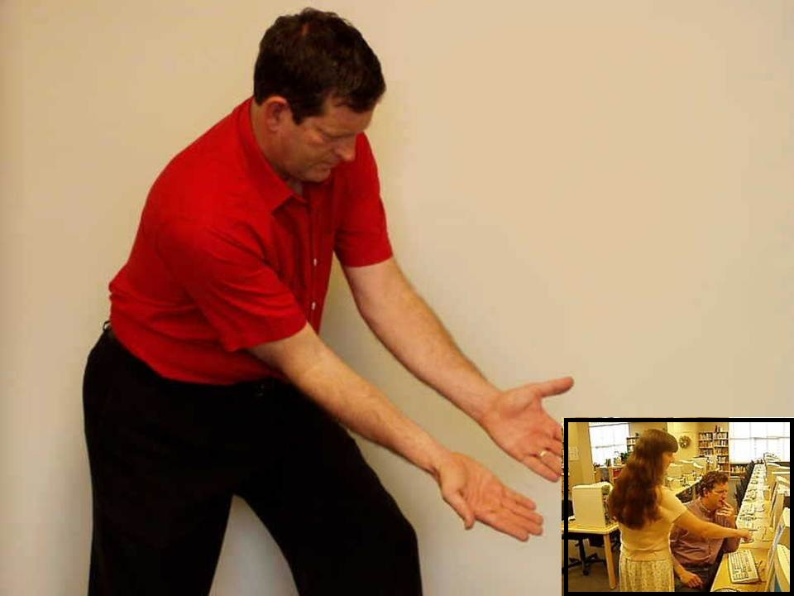

Slide 41
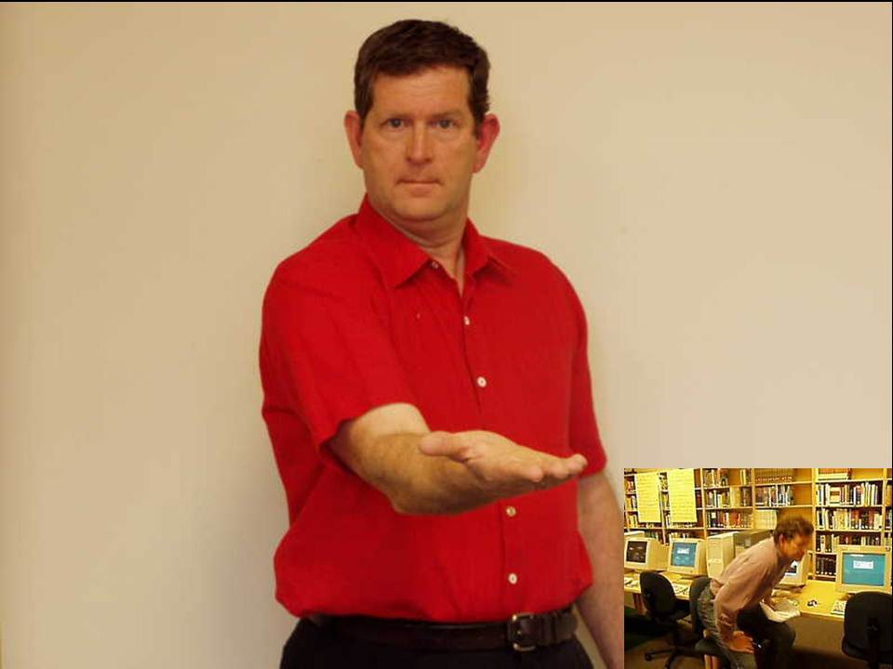

Slide 42
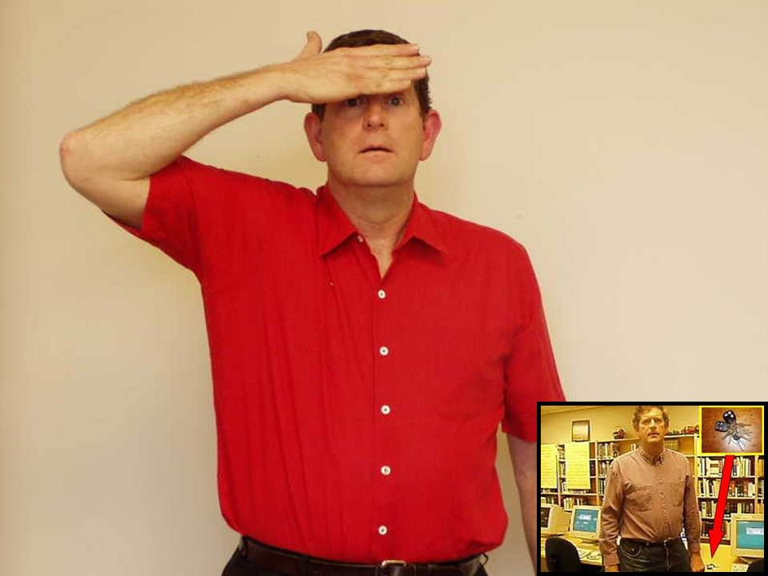

Slide 43
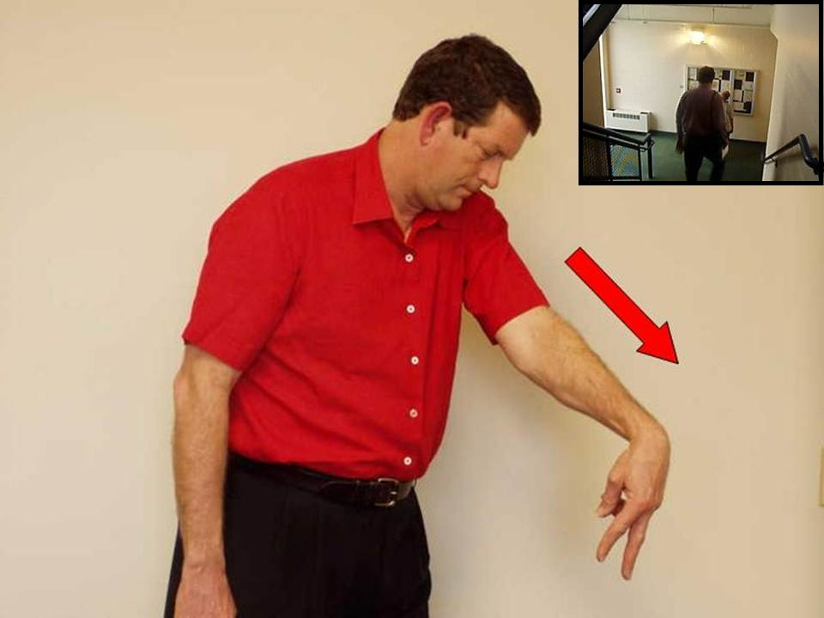

Slide 44
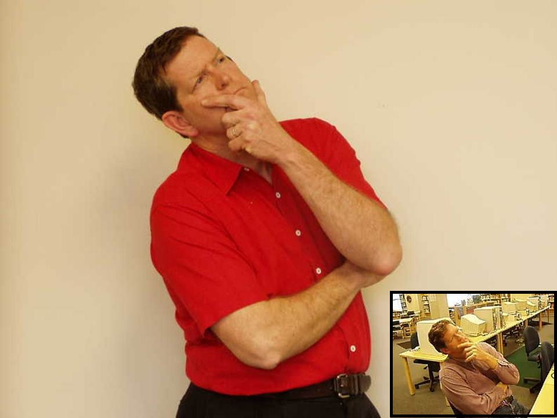

Slide 46
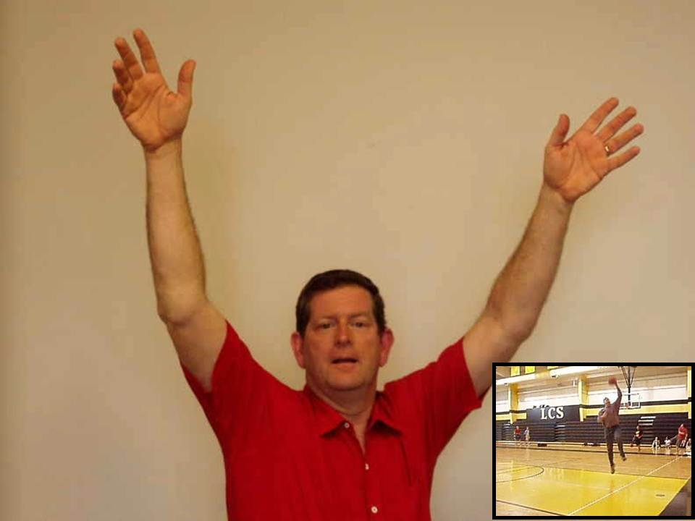

Slide 48
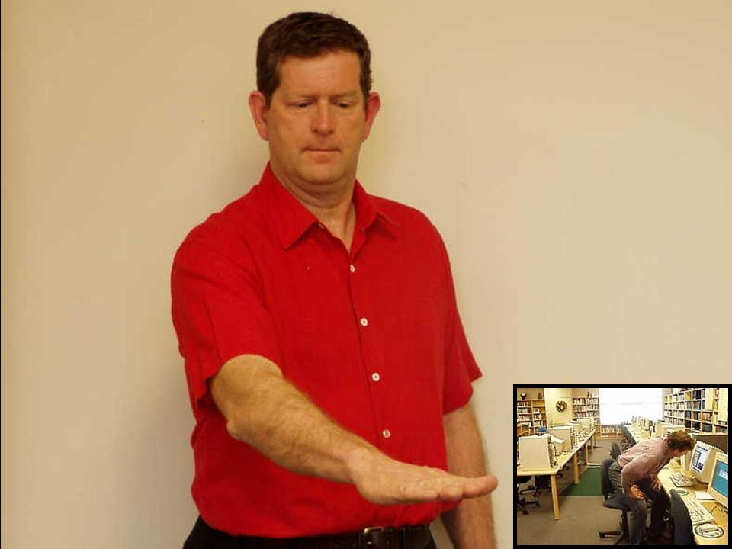

Slide 49
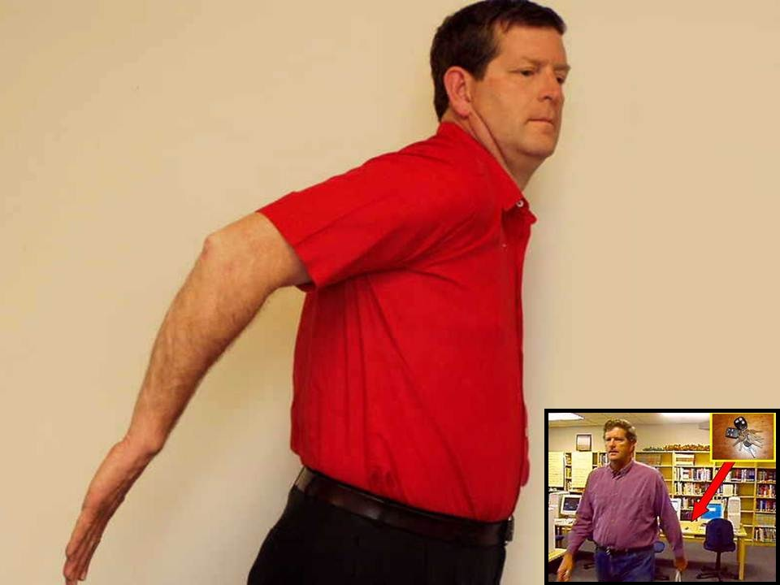

Slide 50
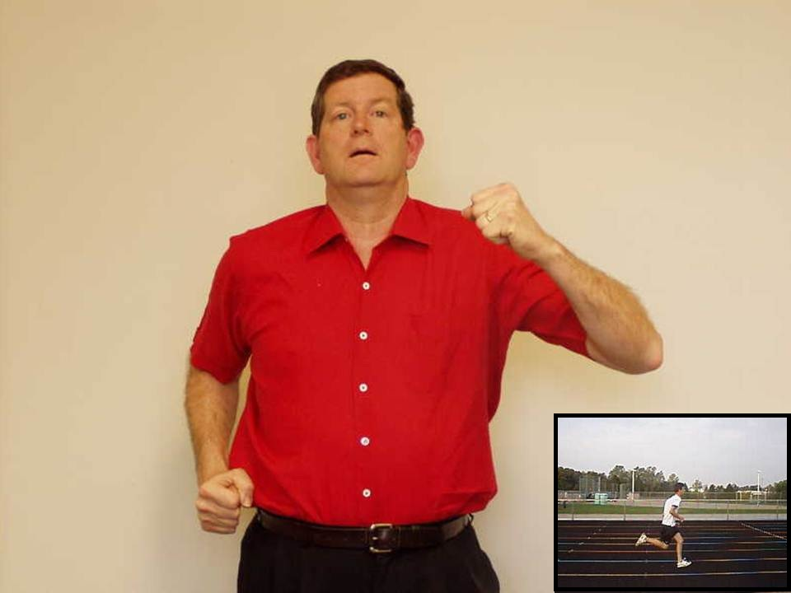

Slide 52
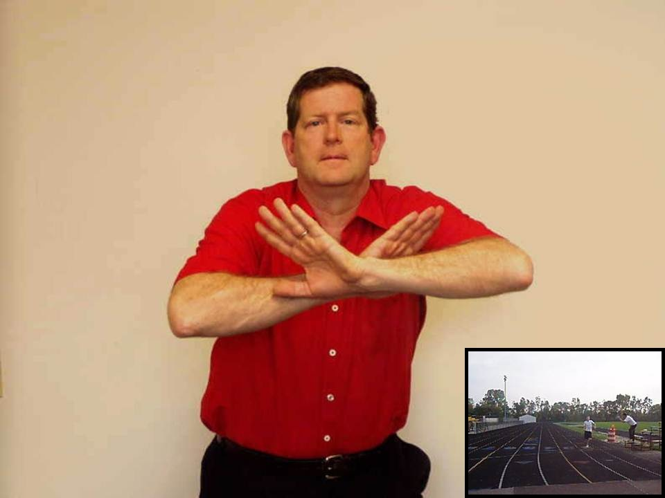

Slide 53
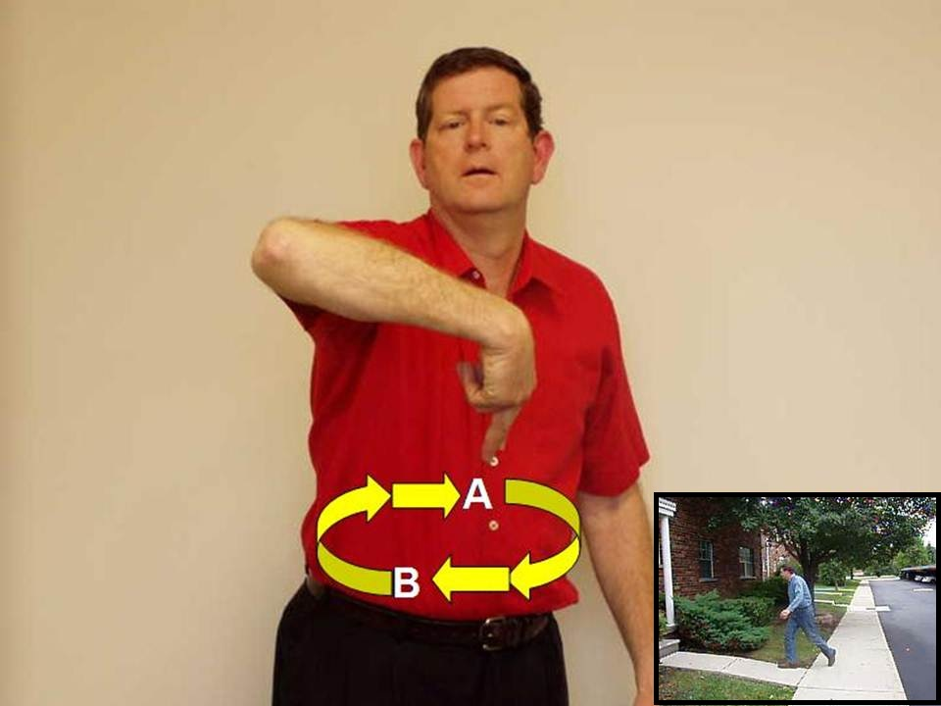

Slide 55
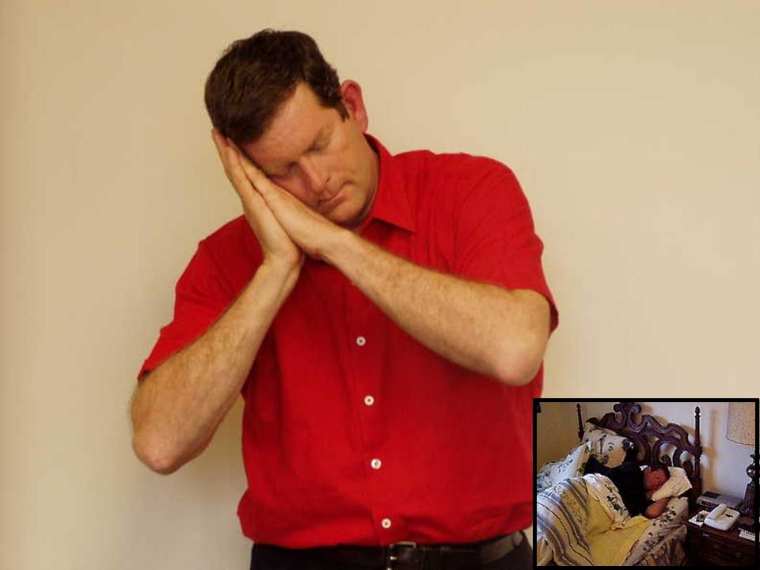

Slide 56
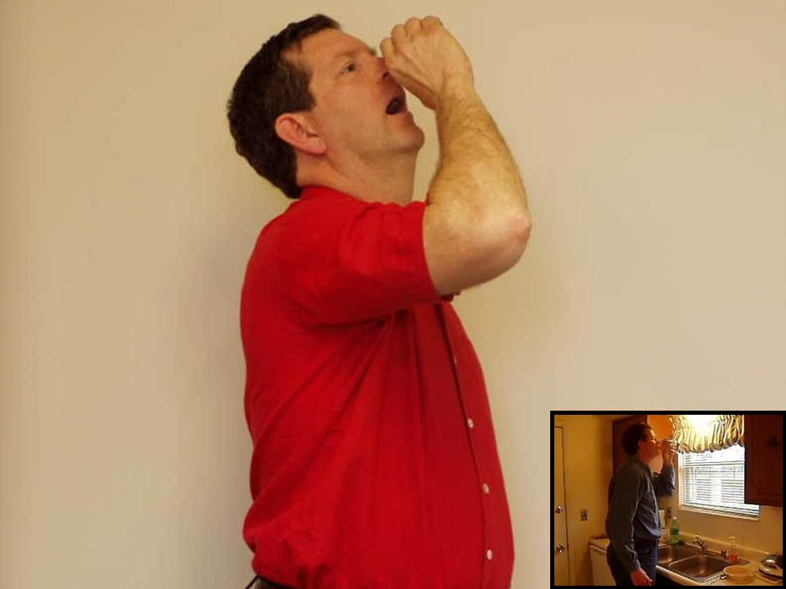

Slide 57
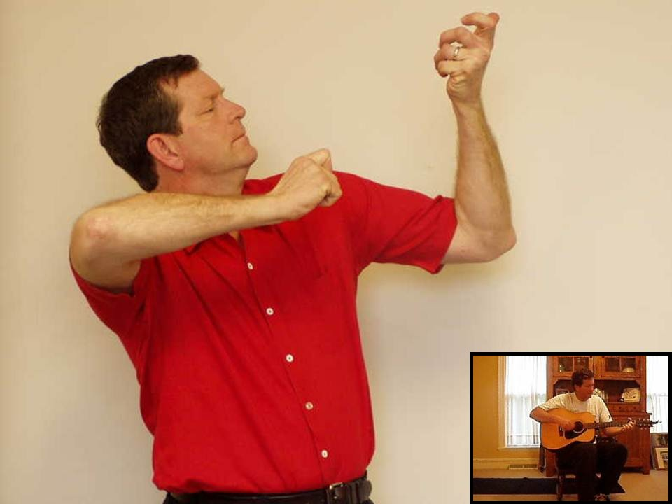

Slide 59
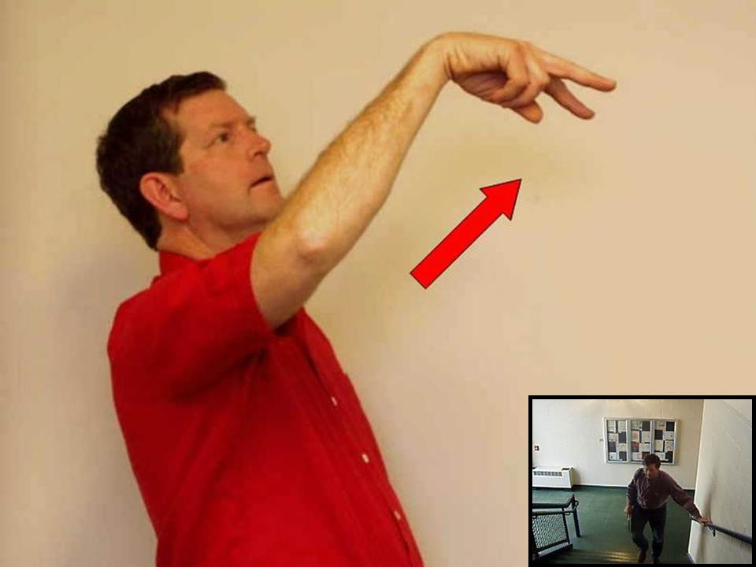

Slide 60
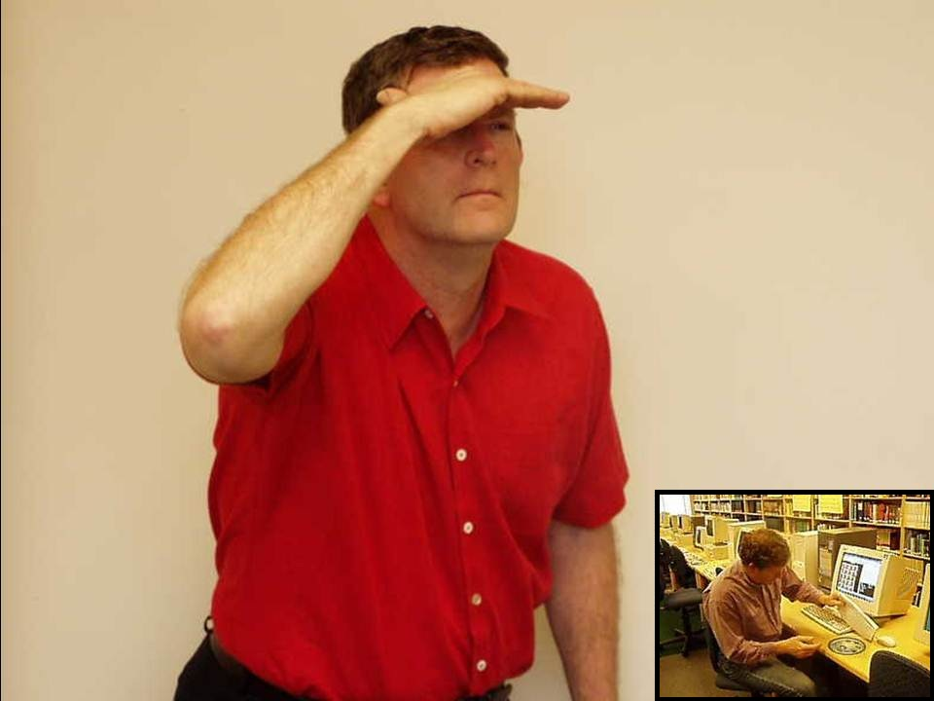

Slide 61
Unit 1
The verb “to be”

Slide 62
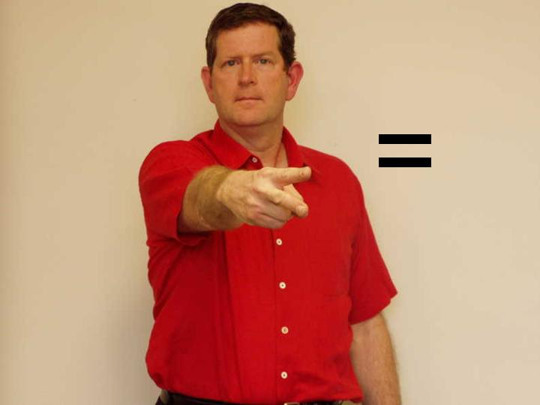

Slide 79
Unit 1
Use of the
Infinitive

Slide 96
Unit 1
Numbers to 100

Slide 97
33

Slide 98
91

Slide 99
59

Slide 100
38

Slide 101
55

Slide 102
73

Slide 103
61

Slide 104
47

Slide 105
62

Slide 106
34

Slide 107
32

Slide 108
50

Slide 109
17

Slide 110
19

Slide 111
14

Slide 112
76

Slide 113
93

Slide 114
97

Slide 115
12
Notes:
115

Slide 116
22

Slide 117
56

Slide 118
82

Slide 119
4
Notes:
119

Slide 120
77

Slide 121
15
Notes:
121

Slide 122
51

Slide 123
15

Slide 124
8

Slide 125
14

Slide 126
31

Slide 127
67

Slide 128
24

Slide 129
22

Slide 130
14

Slide 131
61

Slide 132
79

Slide 133
84

Slide 134
99

Slide 135
44

Slide 136
28
Notes:
136

Slide 137
66

Slide 138
29

Slide 139
9
Notes:
139

Slide 140
88

Slide 141
6

Slide 142
53

Slide 143
46

Slide 144
7

Slide 145
11

Slide 146
24

Slide 147
22

Slide 148
79

Slide 149
76

Slide 150
86

Slide 151
84

Slide 152
Unit 1
Unit 1 Vocabulary

