Slide 1
Unit 2
Interrogatives

Slide 2
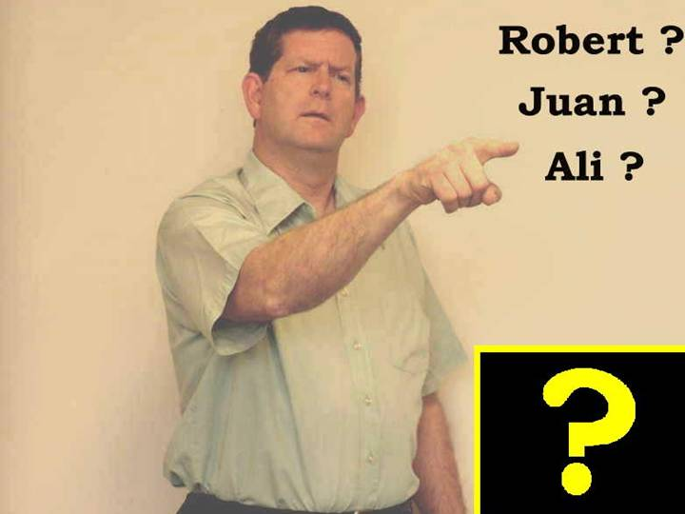
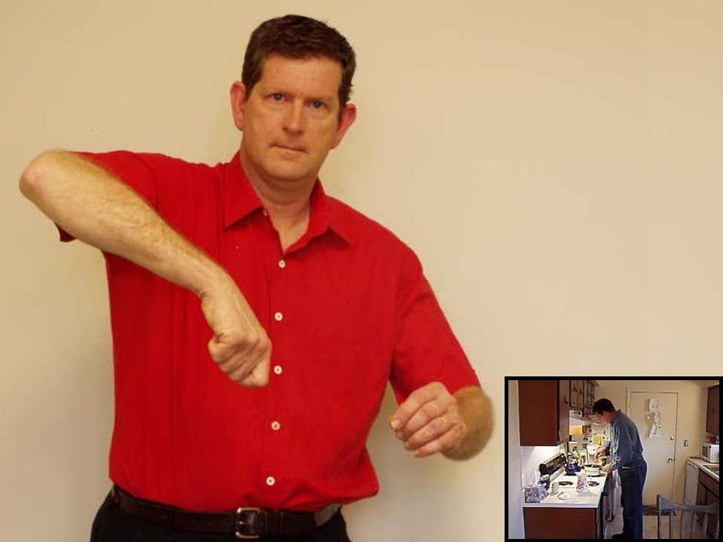
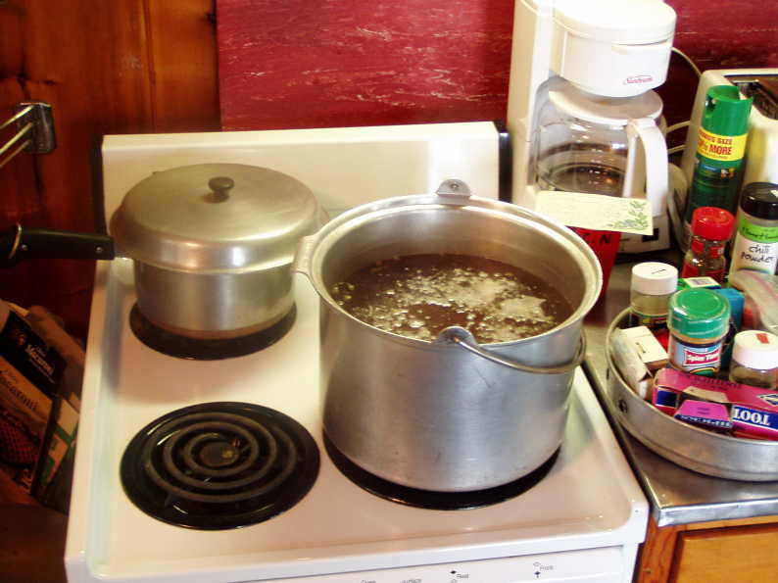

Slide 3
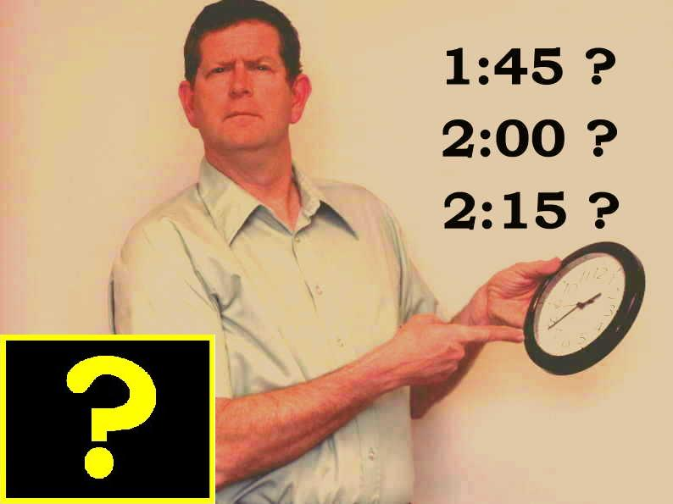
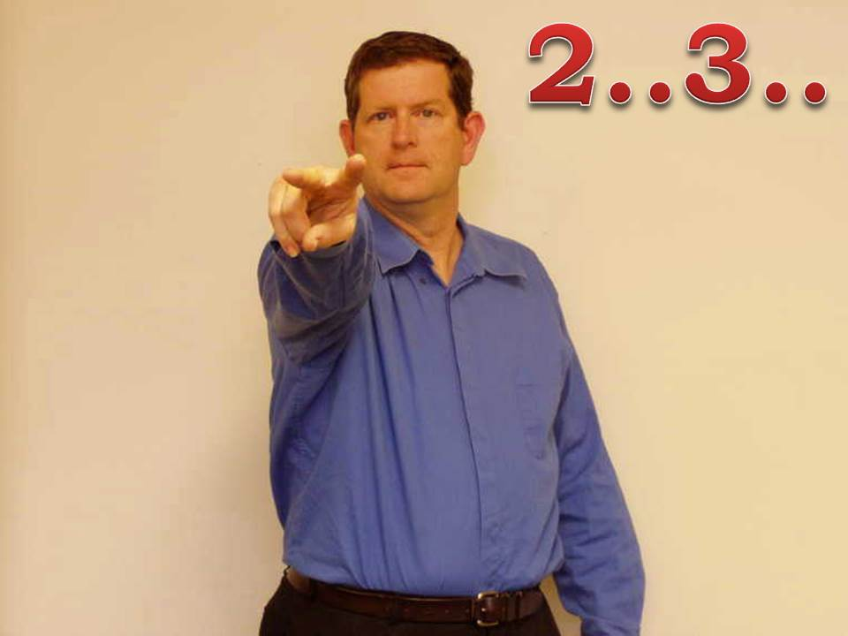
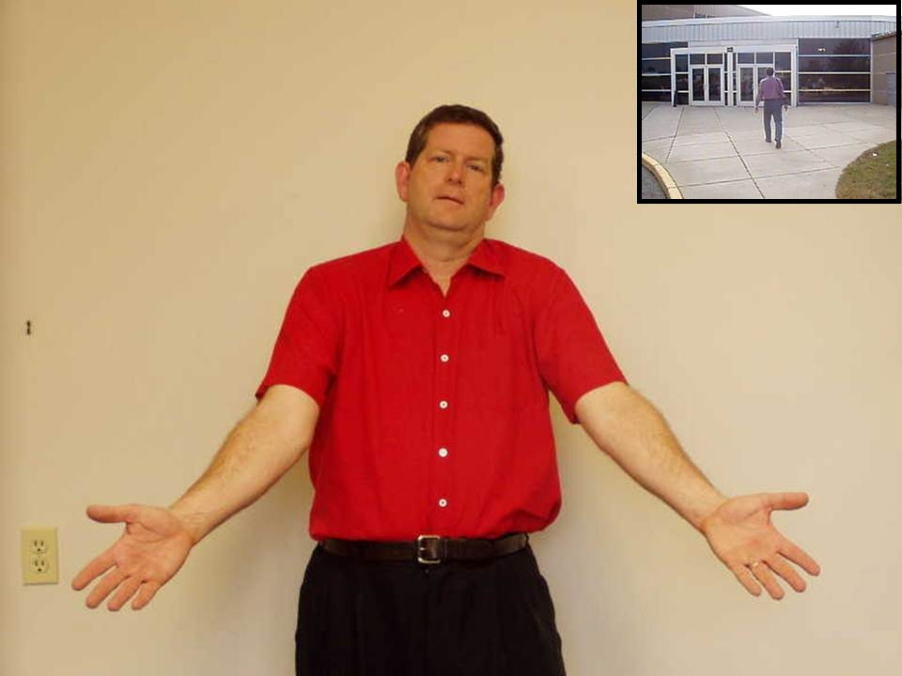

Slide 4
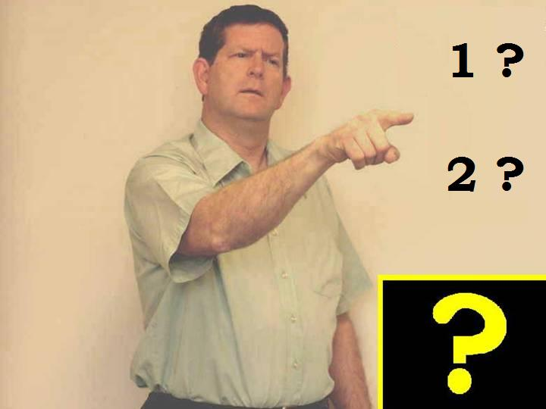
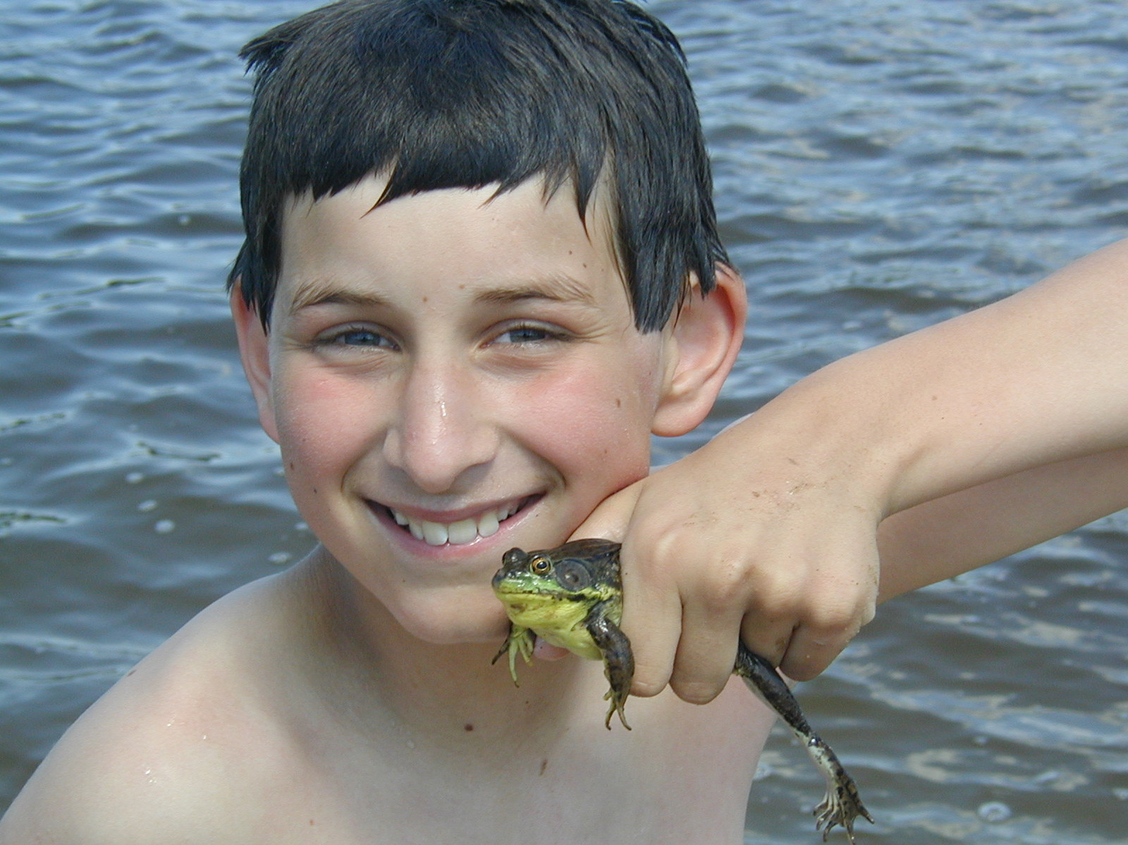
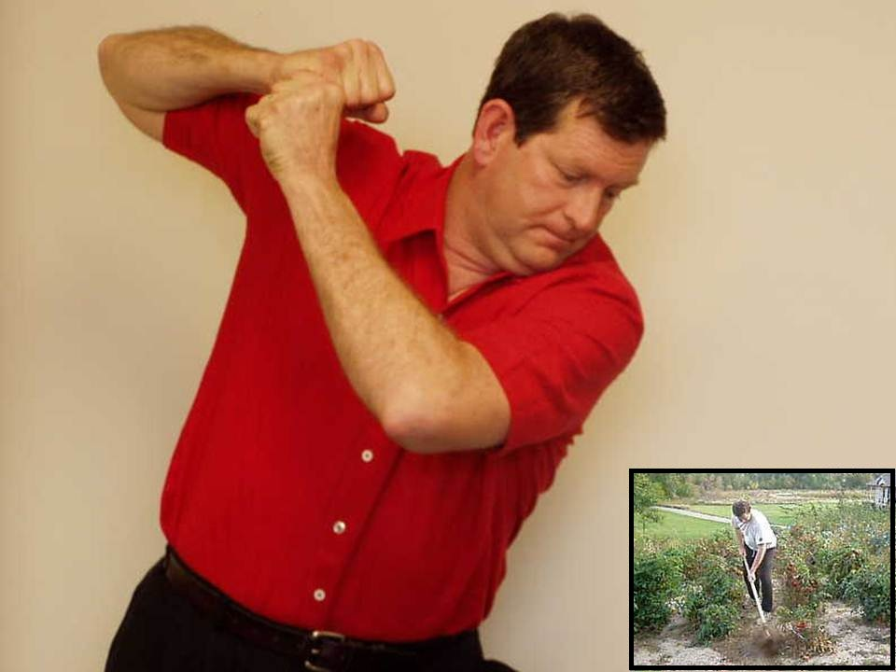

Slide 5
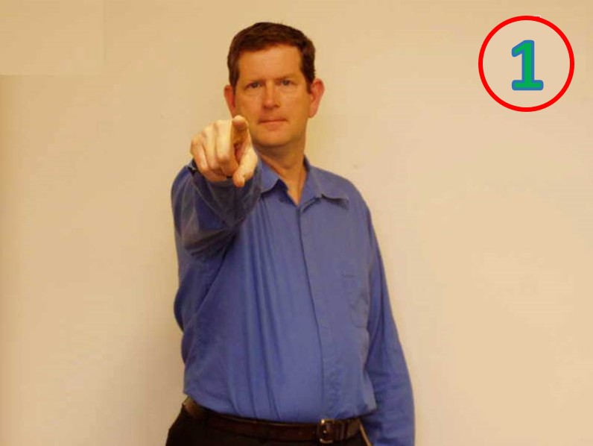
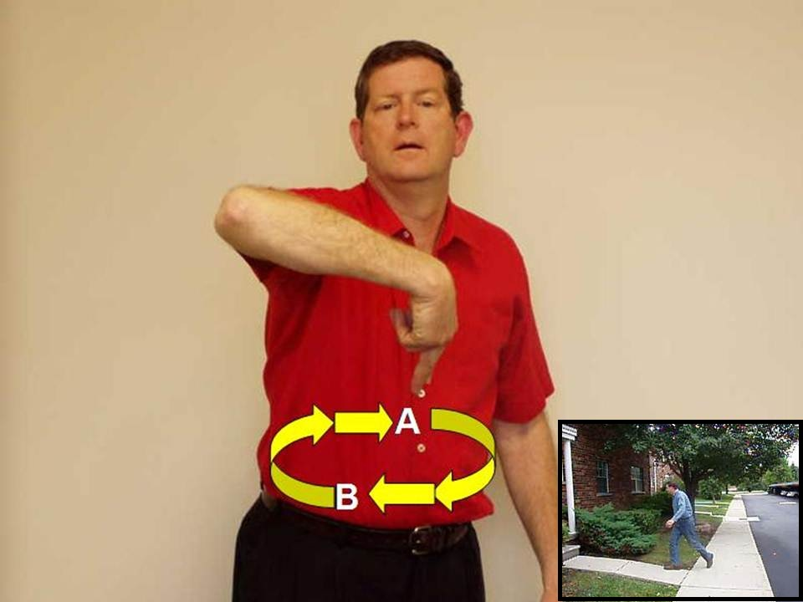

Slide 6
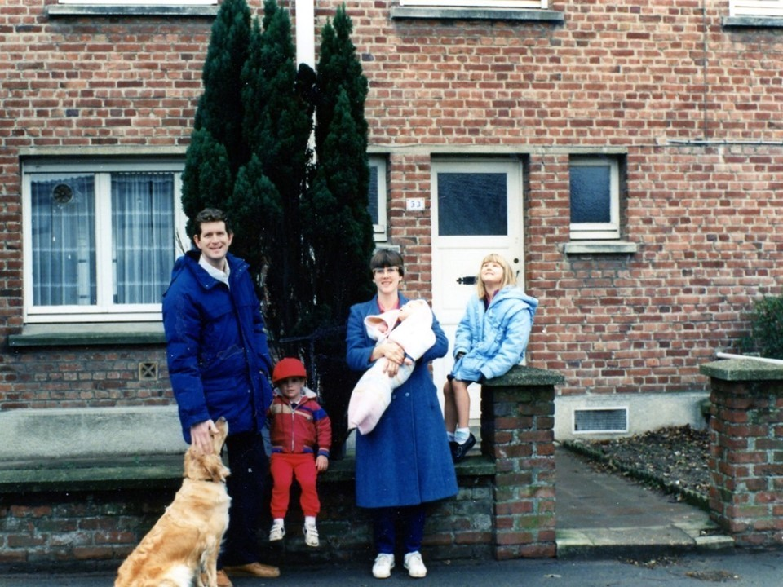
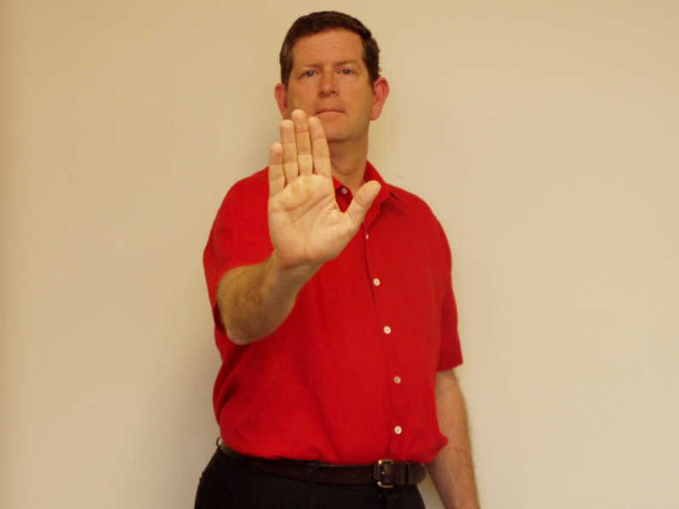

Slide 7
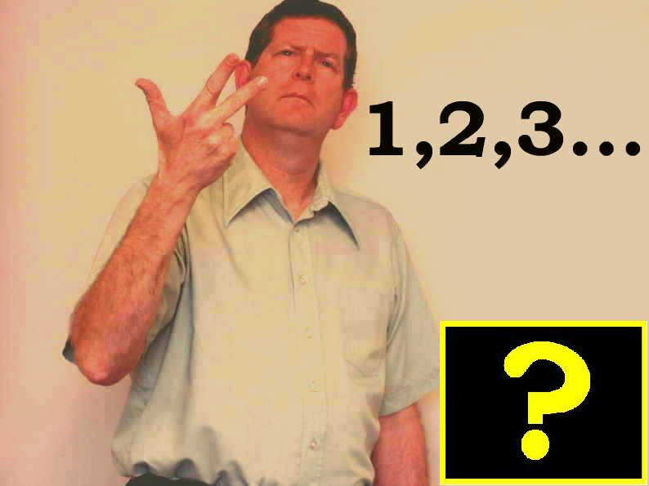
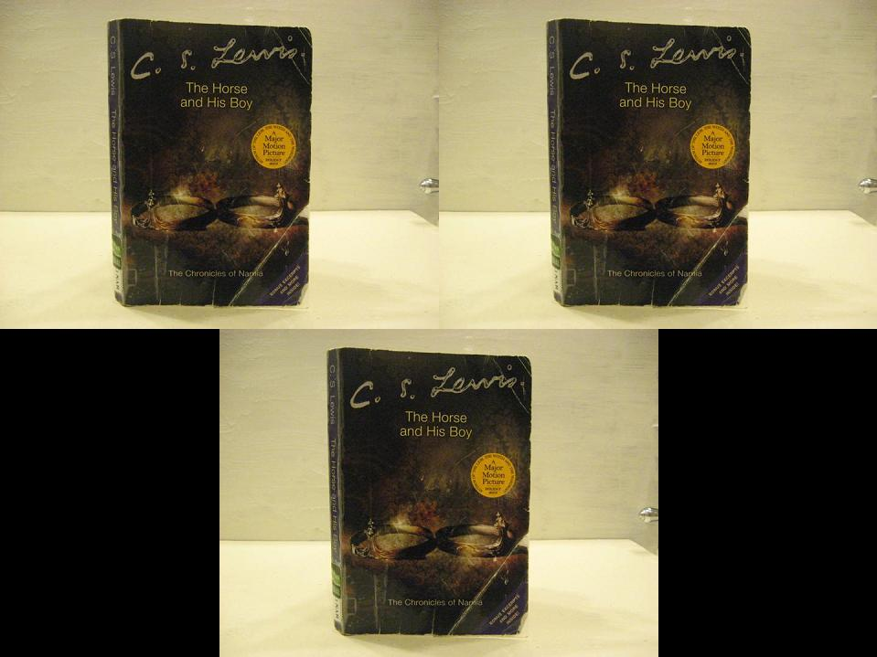
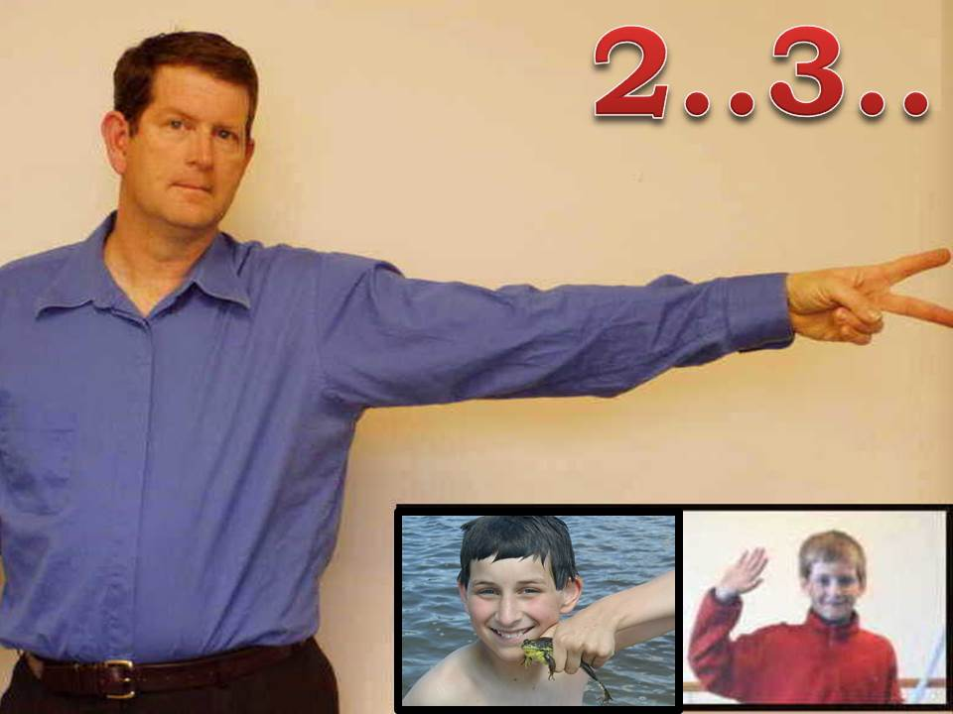
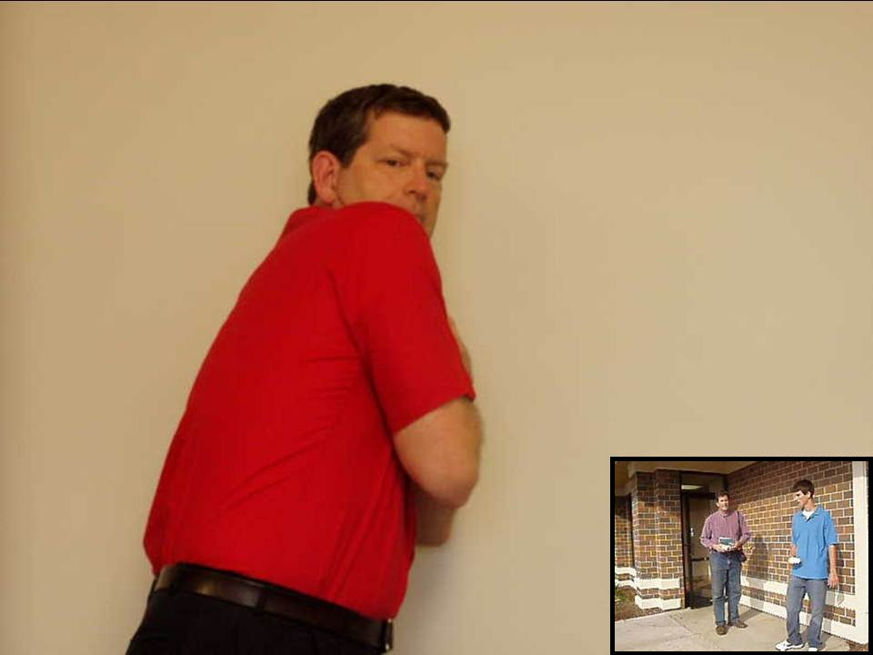

Slide 8
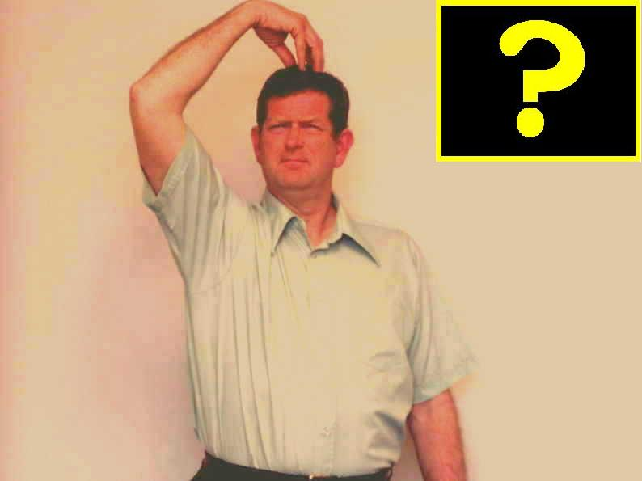
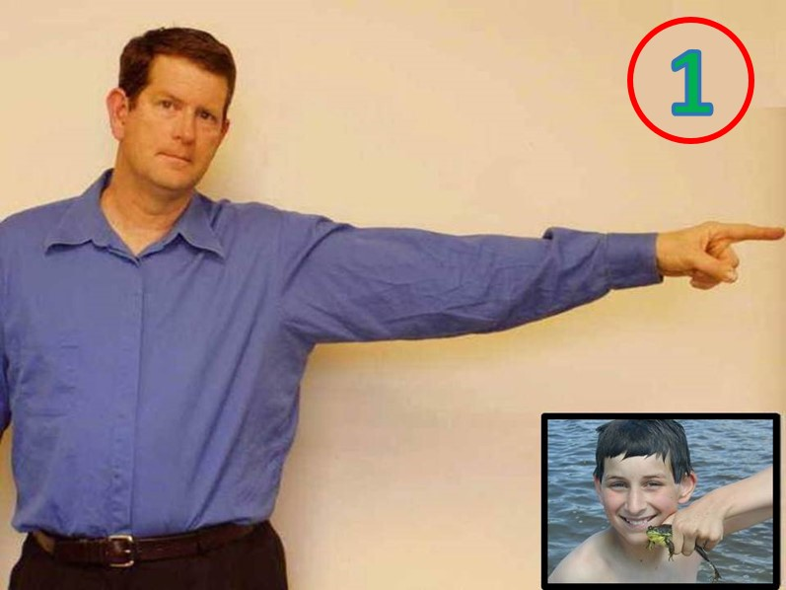
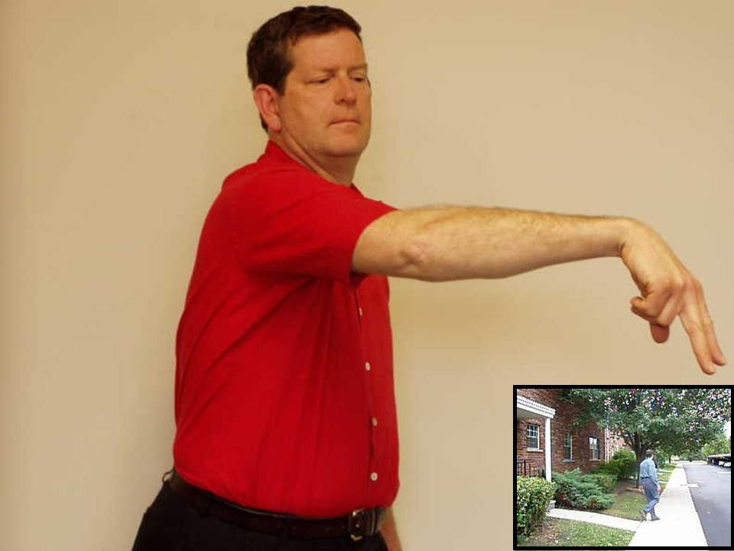

Slide 9
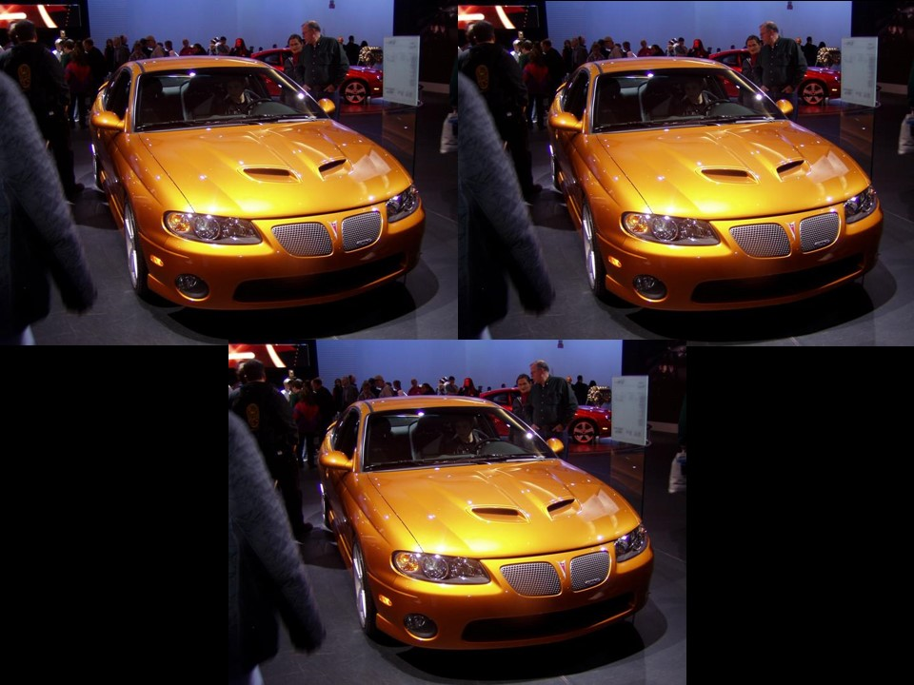
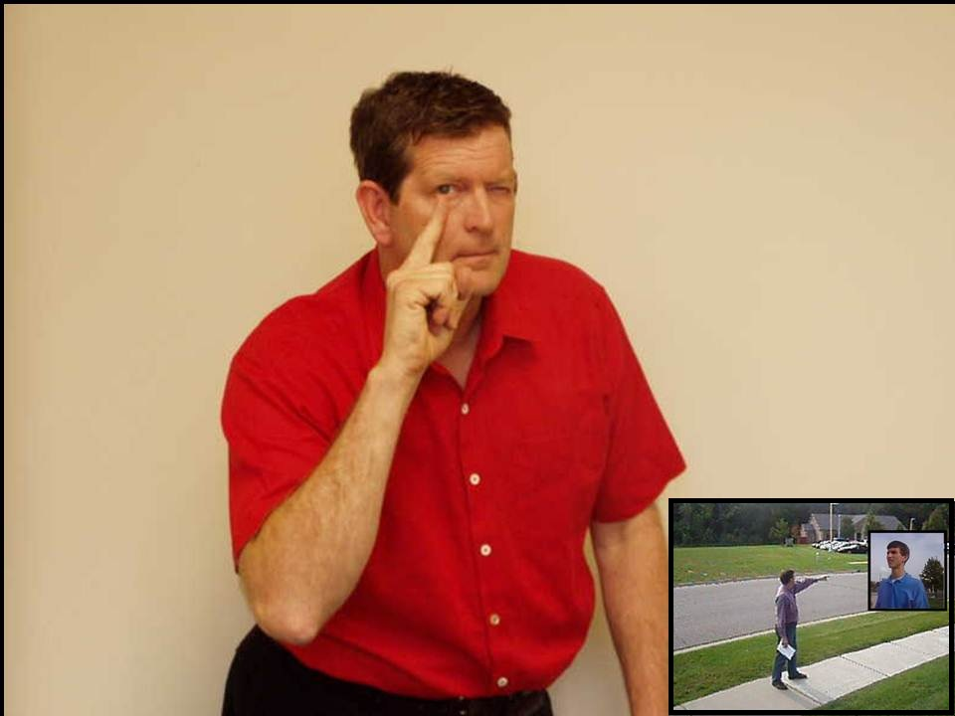

Slide 10
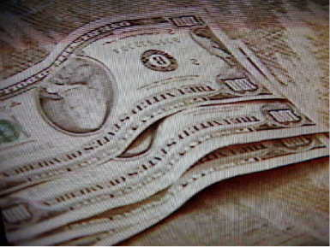
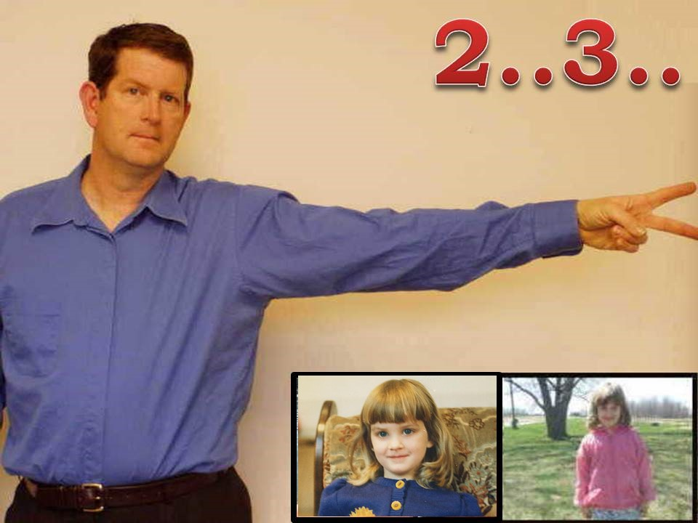
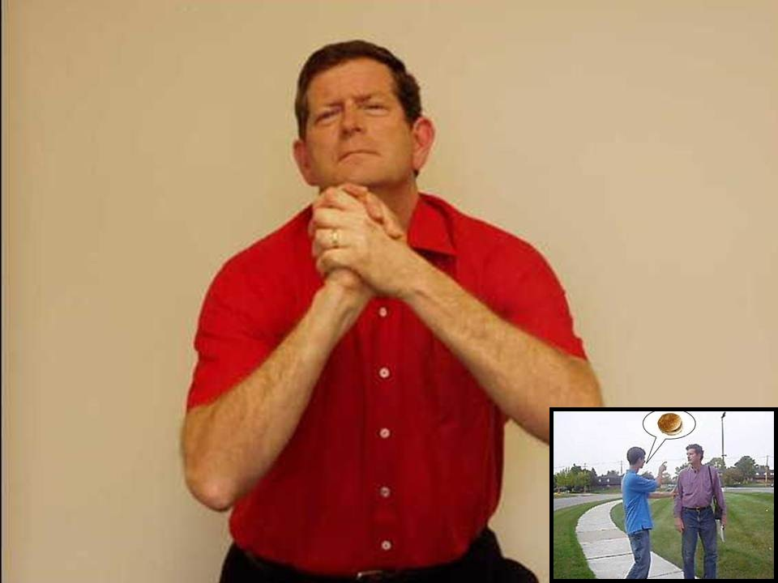

Slide 11
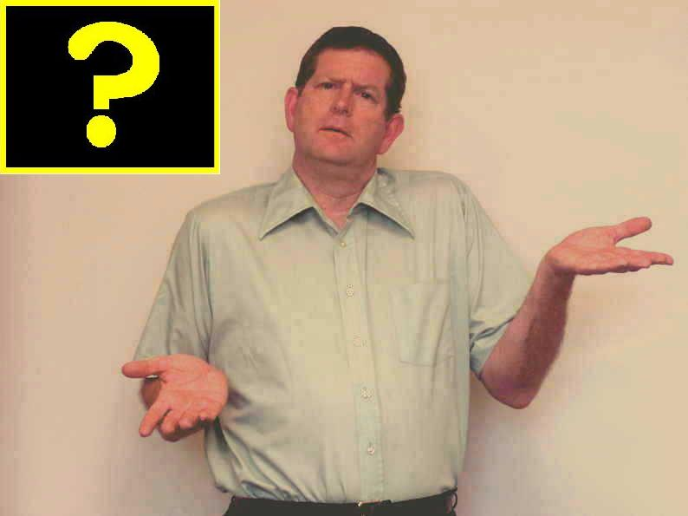
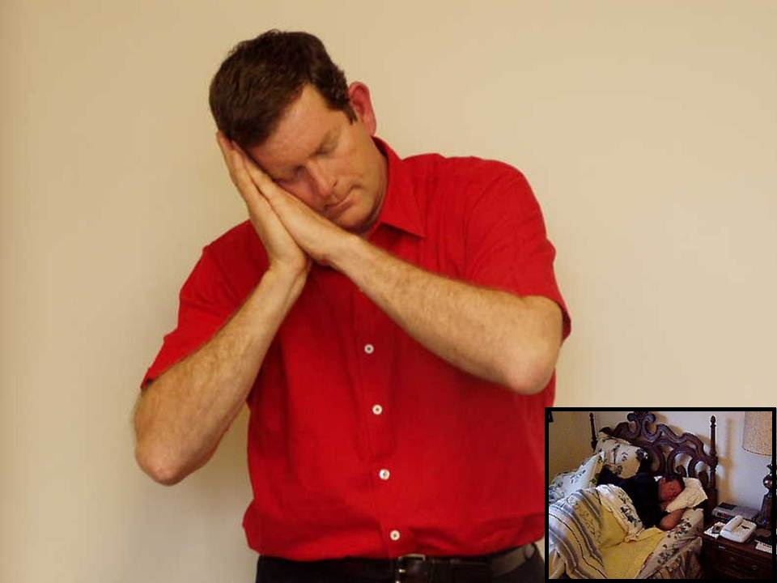

Slide 12
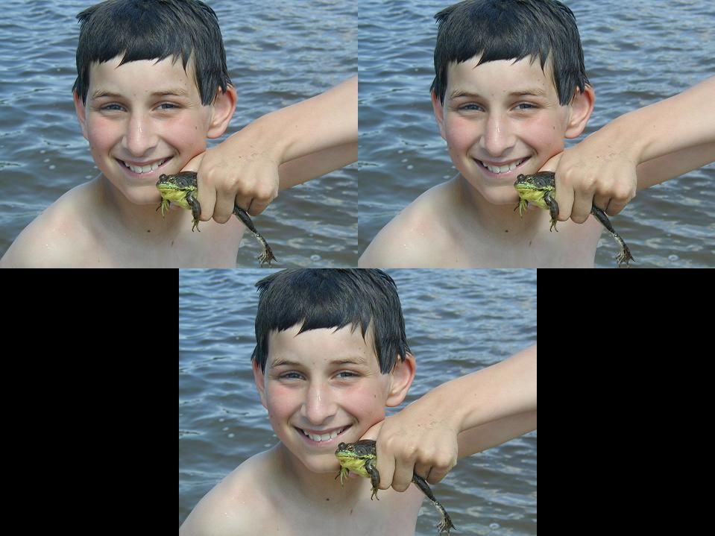
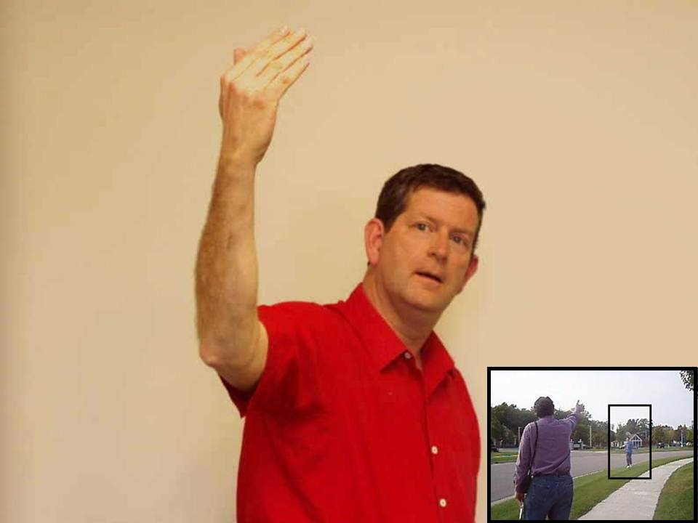

Slide 13
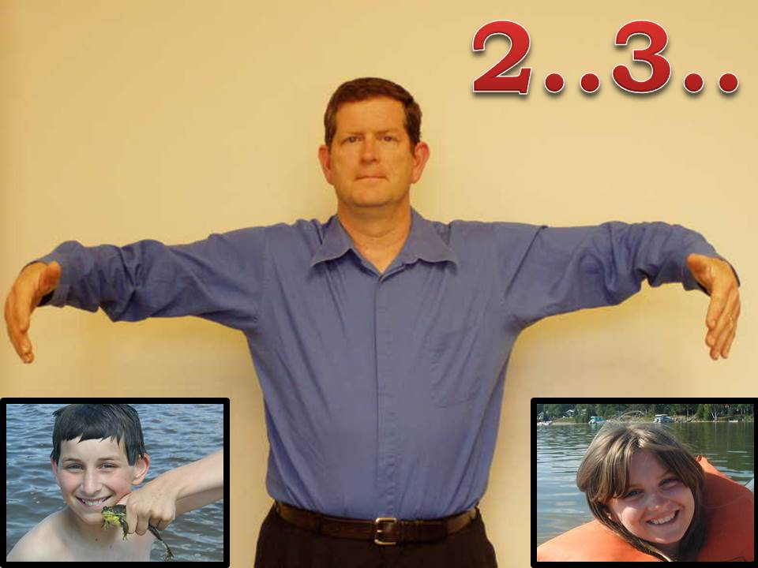
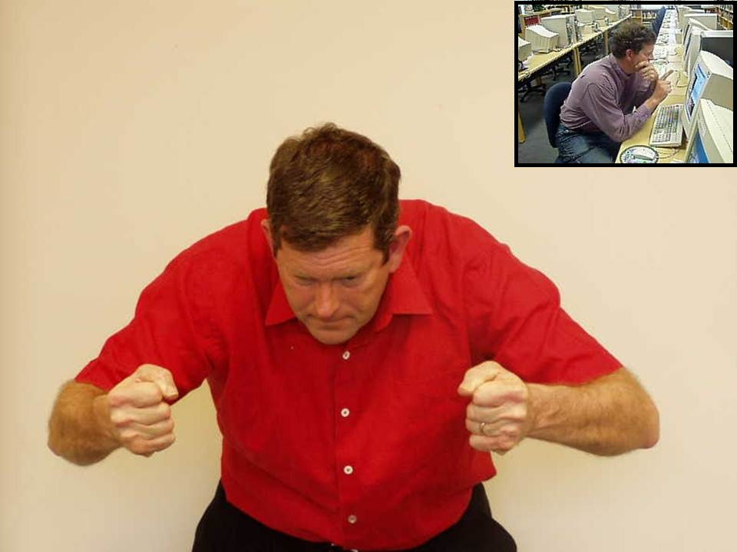

Slide 14
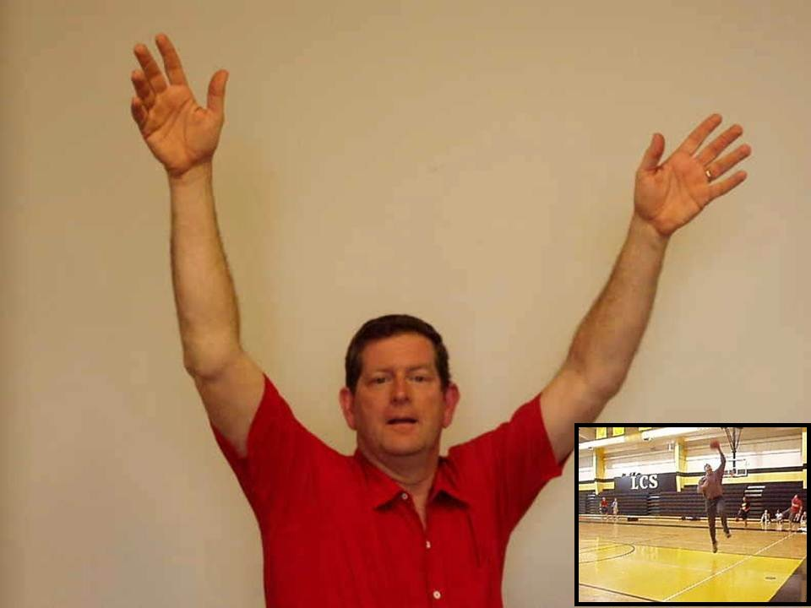

Slide 15
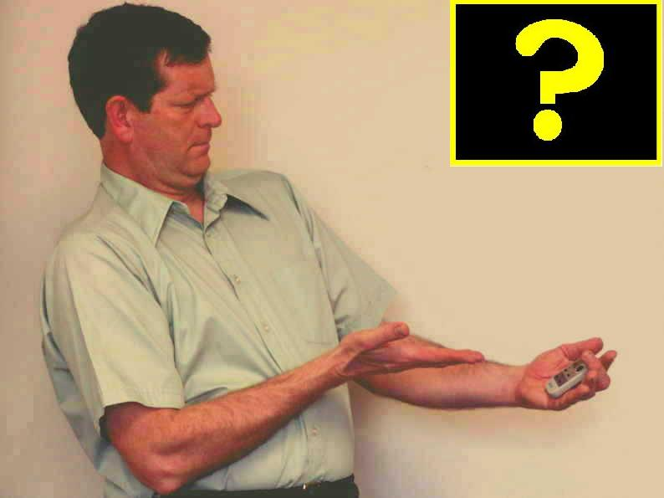

Slide 16
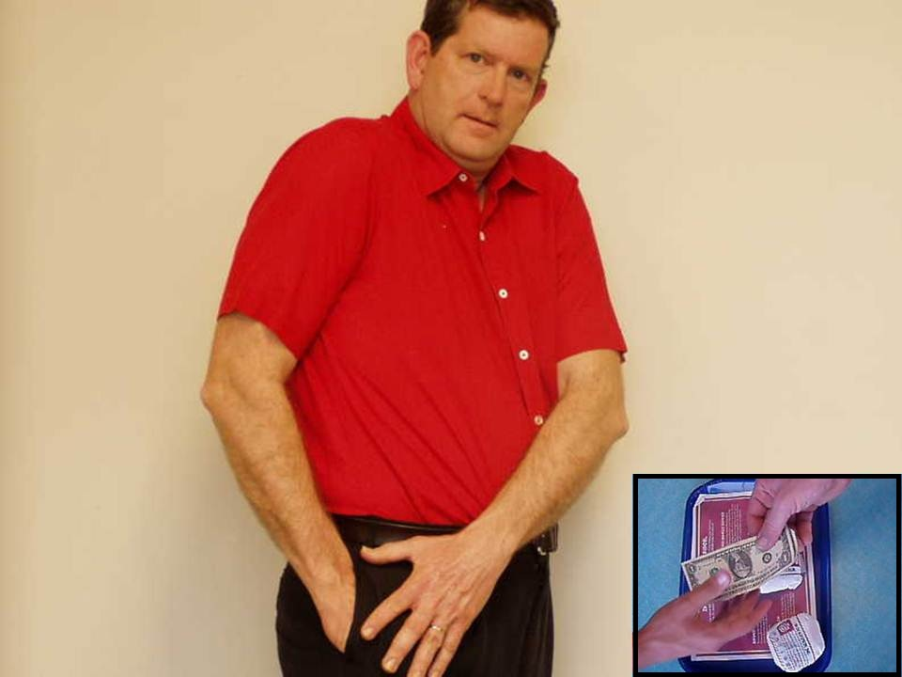
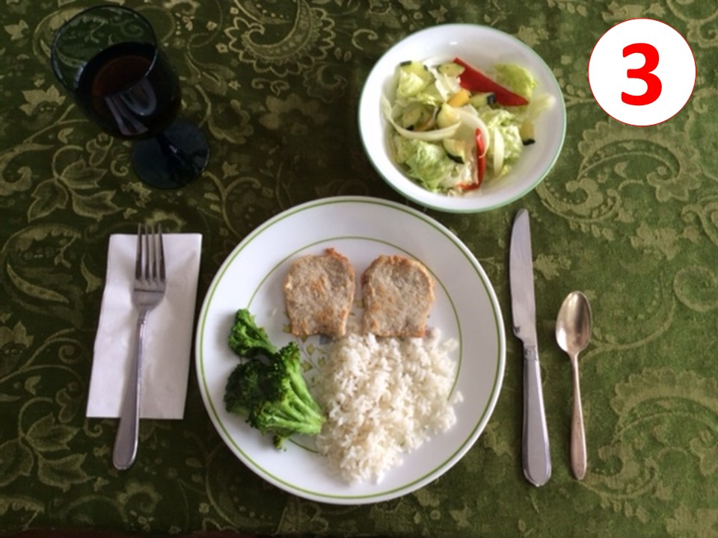

Slide 18

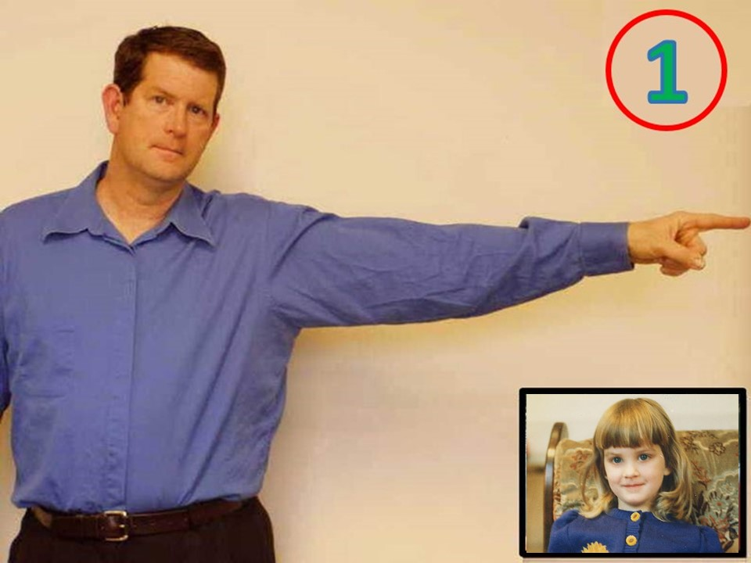
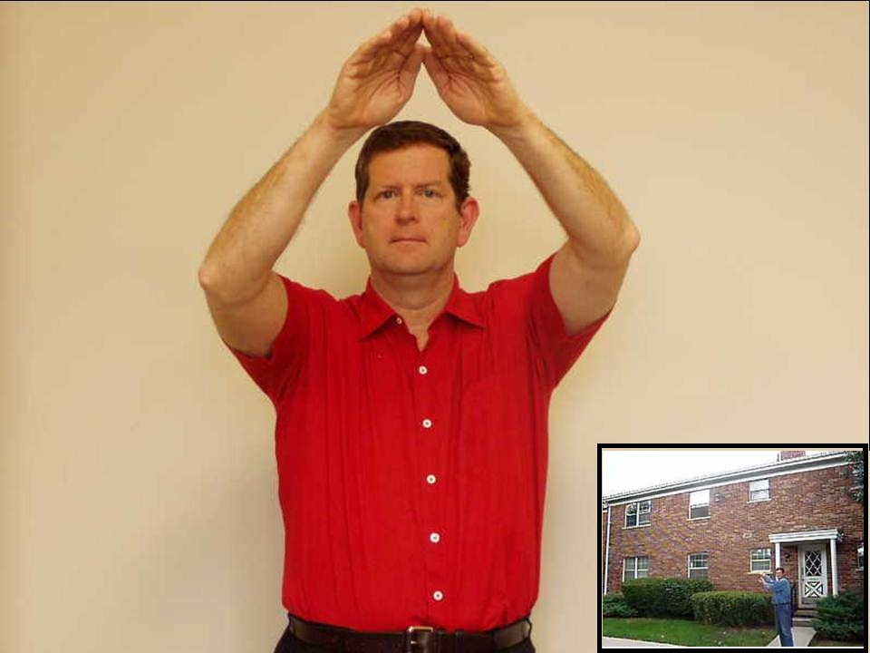

Slide 19
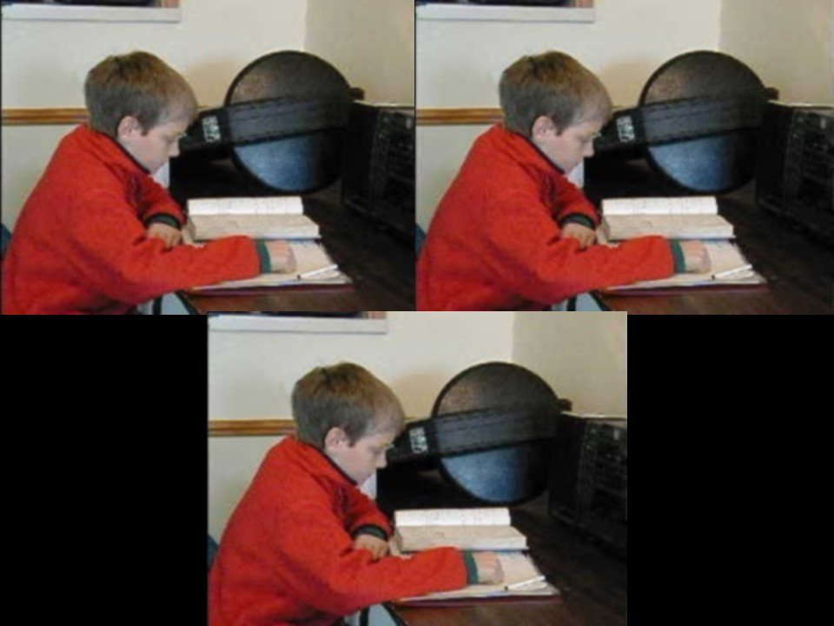
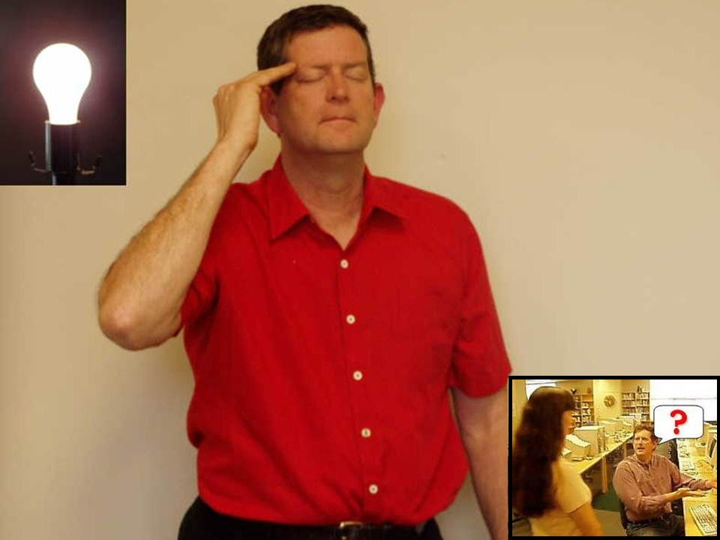

Slide 20
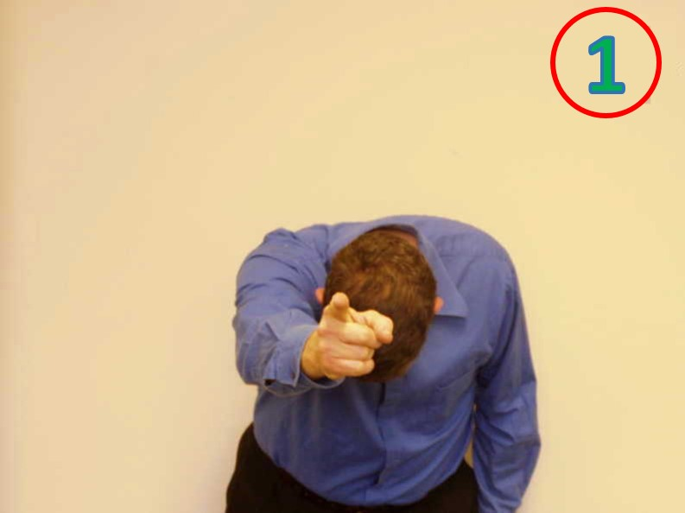
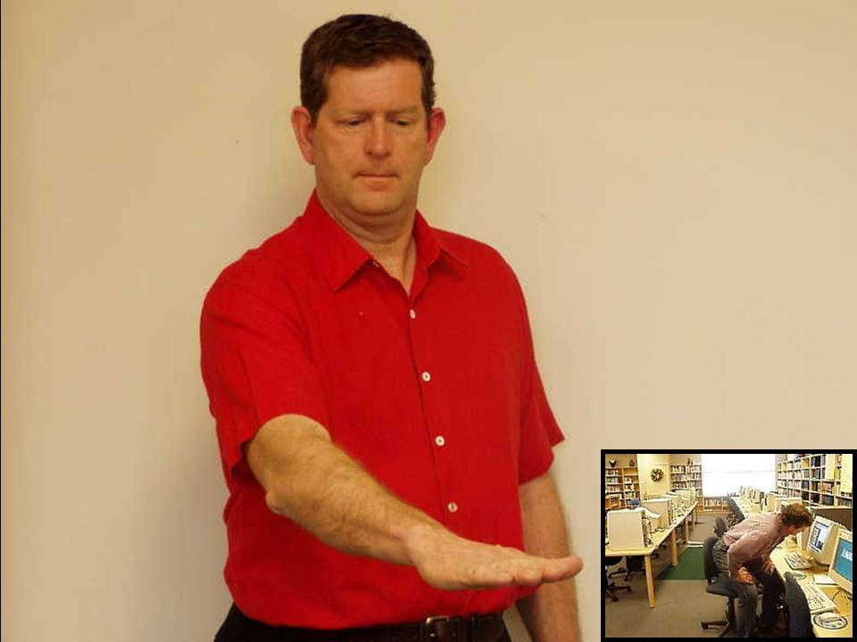

Slide 21
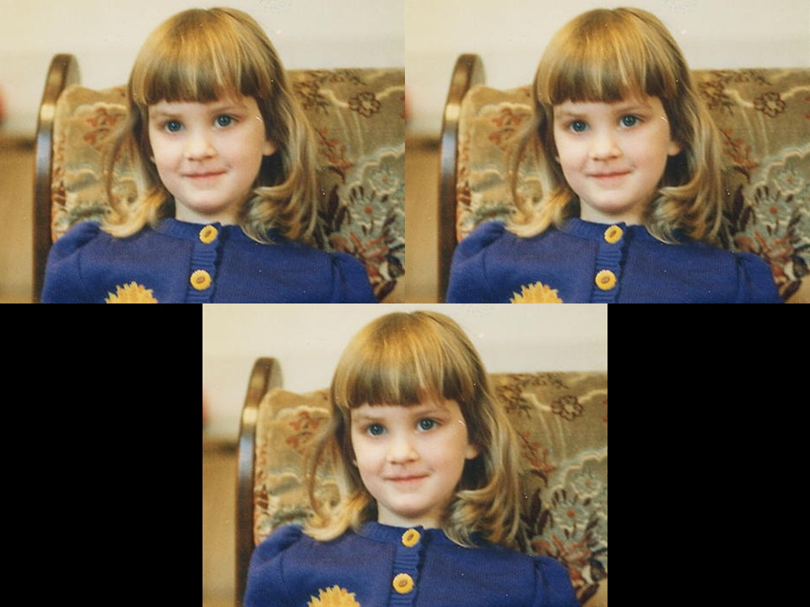
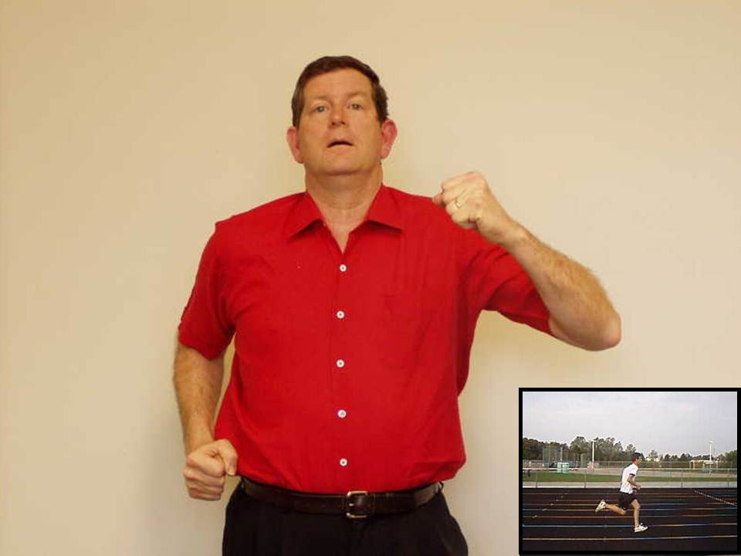

Slide 22
Unit 2
Daily Routine

Slide 23
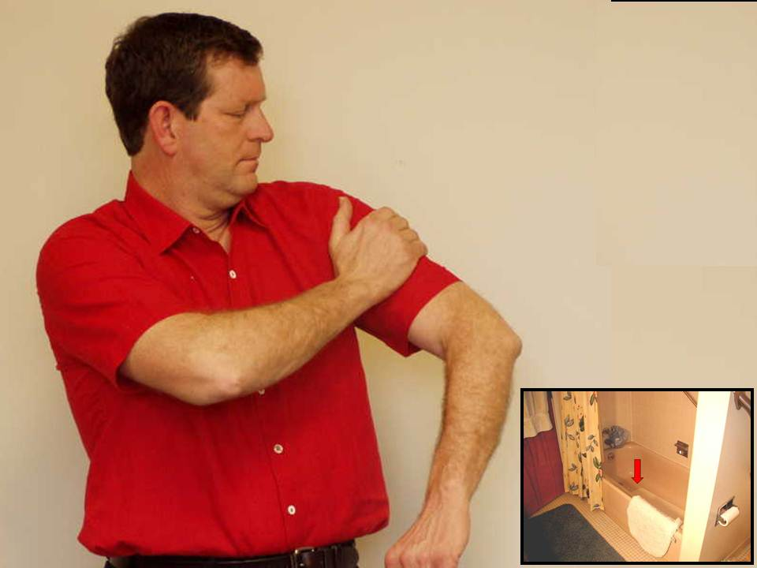

Slide 24
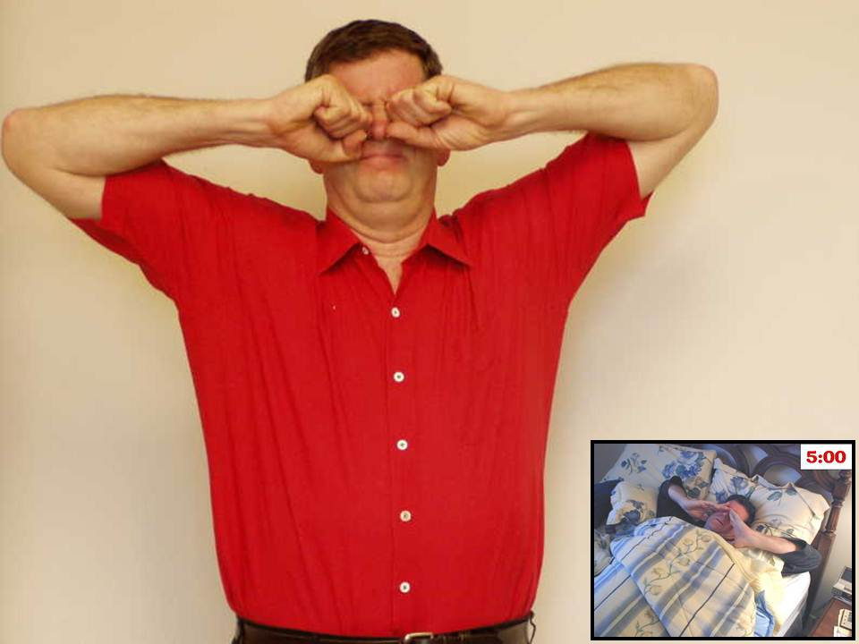

Slide 25
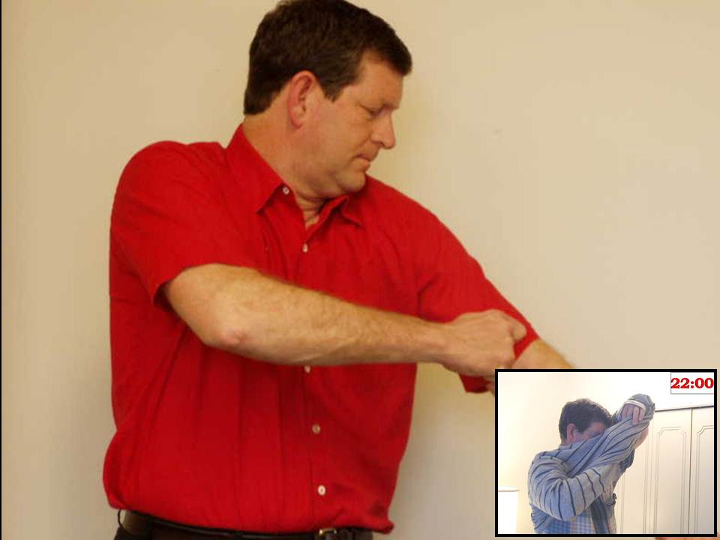

Slide 26
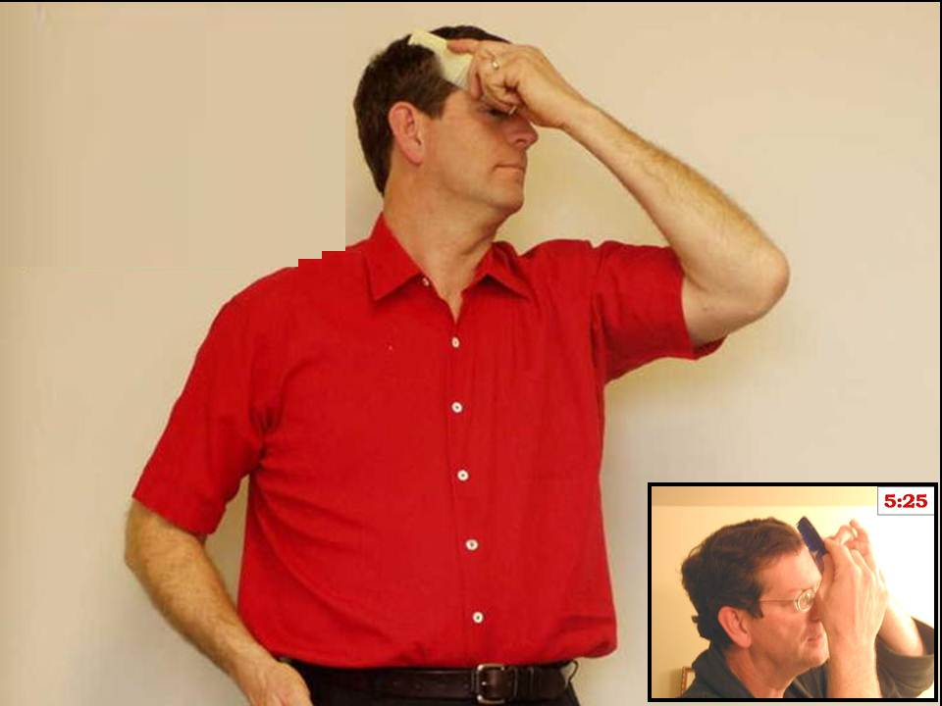

Slide 27
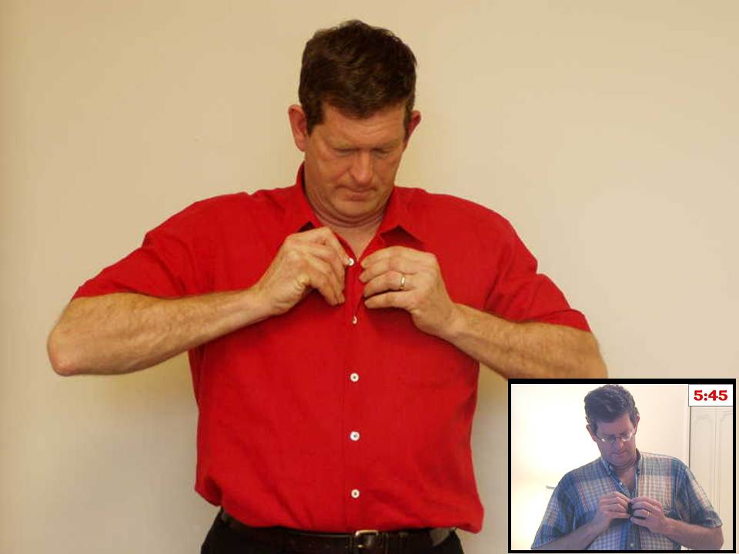

Slide 28
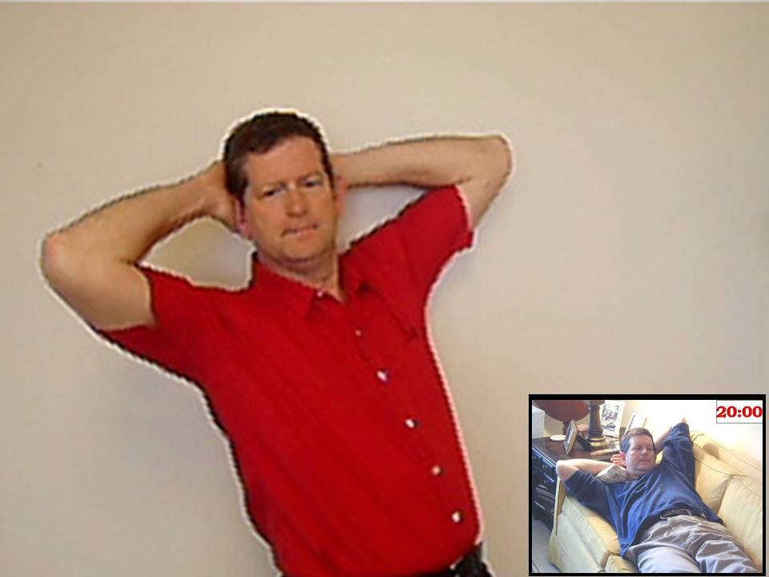

Slide 29
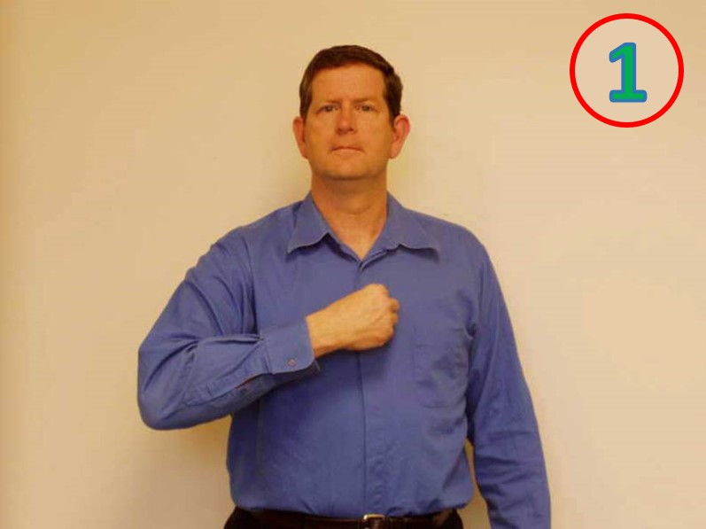


Slide 33


Slide 38


Slide 40


Slide 41


Slide 45
Unit 2
Present Simple
Vs.
Present Progressive

Slide 46


Slide 47


Slide 48


Slide 54


Slide 58


Slide 61


Slide 66
Unit 2
Time

Slide 67
2:10

Slide 68
9:45

Slide 69
10:50

Slide 70
6:30

Slide 71

12:00

Slide 72
3:15

Slide 73

12:00

Slide 74
8:40

Slide 75
1:00

Slide 76
5:25

Slide 77
7:35

Slide 78
4:20

Slide 79
11:55

Slide 80
Unit 2
Modals

Slide 81


Slide 82


Slide 84


Slide 85


Slide 86


Slide 87


Slide 88


Slide 91


Slide 95
Unit 2
Unit 2 Vocabulary

Slide 96


Slide 97


Slide 98


Slide 99


Slide 100


Slide 101


Slide 102


Slide 103


Slide 104


Slide 105


Slide 106


Slide 107


Slide 108


Slide 109


Slide 110


Slide 111


Slide 112


Slide 113


Slide 114


Slide 115


Slide 116


Slide 117


Slide 118


Slide 119


Slide 120


Slide 121


Slide 122


Slide 123


Slide 124


Slide 125


Slide 126


Slide 127


Slide 128


Slide 129


Slide 130


Slide 131


Slide 132


Slide 133


Slide 134


Slide 135


Slide 136


Slide 137


Slide 138


Slide 139


Slide 140


Slide 141


Slide 142


Slide 143


Slide 144


Slide 145


Slide 146


Slide 147


Slide 148


Slide 149


Slide 150


Slide 151


Slide 152


Slide 153


Slide 154


Slide 155


Slide 156


Slide 157


Slide 158


Slide 159


Slide 160


Slide 161


Slide 162


Slide 163


Slide 164


Slide 165


Slide 166


Slide 167


Slide 168


Slide 169


Slide 170


Slide 171


Slide 172


Slide 173


Slide 174


Slide 175


Slide 176


Slide 177


Slide 178


Slide 179


Slide 180


